Slide 1
Developing CE Courses and Getting Them Sponsored
Kristi Casale, CMP, DMCP
Senior Meetings & Continuing Education Director

Slide 2
How to Identify Topics
Identify the learner – who is your target audience?
Who is attending and why would it benefit them?
Understand the needs of your target audience
Review the comments in your past evaluations to determine topics. Conduct a survey
Read articles, talk to industry peers
Create balance for your total audience
Consider offering a variety of courses to meet the needs of early career, as well as seasoned experts looking to expand their knowledge
Notes:
Be competitive. What content is a benefit to being at the local level. Use that to help your members.

Slide 3
Development of the Content
Build the education by aligning course objectives, teaching and learning strategies and outcomes
Use a backward approach where outcomes are developed first and the course is designed by progressing from there
Write learner centered objectives
Bring in fresh faces: AAPD Speakers Bureau
Be sure to teach to the AAPD Guidelines
Clearly communicate the knowledge and skills to be gained
Notes:
Capture their attention and keep it.
Expect remarkable events

Slide 4


Each member of the AAPD Speakers Bureau was carefully reviewed and approved by the AAPD Speakers Bureau Committee. This Speakers Bureau connects state, districts and dental institutions to the leading experts in the world of pediatric dentistry.
Behavior Guidance
Dental Caries: Diagnosis & Treatment
Growth & Development
Oral Pathology
Patient Management
Practice Management
Preventive
Pulp Therapy
Restorative
Sedation
Special Healthcare Needs
Syndromes/Craniofacial Anomalies
Trauma

Slide 5
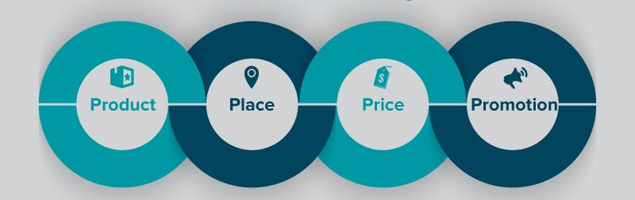
Marketing Your Course
Product: how are you delivering the education and what are those benefits and is it meeting the needs of the intended audience
Place: Access. Where is the registration for CE? How do they buy it?
Price: Articulate the benefits relative to price. Value is the most important approach.
Promotion: Educate your audience on the existence of your course. Email, website, social media, print, word of mouth
Notes:
Proper Planning Prevents Poor Performance
Tell a story from the beginning. Benefits. Networking. Face to Face. Value.

Slide 6
Coordination with AAPD
AAPD will help promote your CE by including the courses in our eNews which is distributed bi-monthly
Don’t directly compete with AAPD courses. This refers to a program outside of the chapter’s state or district with intent to offer annually or on a consistent basis.
AAPD coordinates the time and place of our CE offerings to make sure they don’t conflict with chapter CE courses.
Notes:
Proper Planning Prevents Poor Performance
Tell a story from the beginning. Benefits. Networking. Face to Face. Value.

Slide 7
Securing Sponsorship
Learn what’s important to potential sponsors
Have options at different price points
Create a customized opportunity
Identify benefits to demonstrate their ROI
Talk to your peers to share best practices
Notes:
Tell your story and then listen.
Make them an offer they can’t refuse

Slide 8




AAPD CE Opportunities
In-person Education
CE Courses
Annual Session
Education Passport
Pedo Teeth Talk – Podcasts!
Notes:
Tell your story and then listen.
Make them an offer they can’t refuse

Slide 9

See you here!

