Slide 1
Public Policy Advocates Workshop 2018
Expansion of the Washington State
ABCD Program to include Children with Disabilities
Age 6-12
Dr. John Gibbons
PPA, Washington State Academy of Pediatric Dentistry
WSDA, Board of Directors

Slide 2
What is the ABCD Program?
Access to Baby & Child DentistryTM

Slide 3
Establish a dental home by age one
Train dentist in best practices for young children
Community Coordinator
Increase reimbursement rates for children O-5
Family Oral Health Education (FOHE)

Slide 4
ADA Health Policy Institute
Key Messages
Wisconsin, Washington, and California had the
lowest Medicaid reimbursement rates for both
adult and child dental care services among
states that
provide dental services via fee-for-service.
Medicaid Fee-For-Service Reimbursement
Rates for Child and Adult Dental Care
Services for all States, 2016
Authors: Niodita Gupta, M.D., M.P.H., Ph.D.; Cassandra Yarbrough, M.P.P.; Marko Vujicic, Ph.D.; Andrew Blatz, M.S.; Brittany Harrison, M.A.

Slide 5
Success of the ABCD Program
The ABCD program saves over $525 per child over 5 years in treatment cost
From 1997-2008, the number of Medicaid children receiving dental treatment doubled (40,000-107,000)
The rate of untreated decay was cut in half between 2005-2010 (26%-13%)
Age one dental care from 3% in 1997 - 32.2% in 2016 (40,000)

Slide 6
How was the ABCD program expanded to include children with disabilities ?

Slide 7
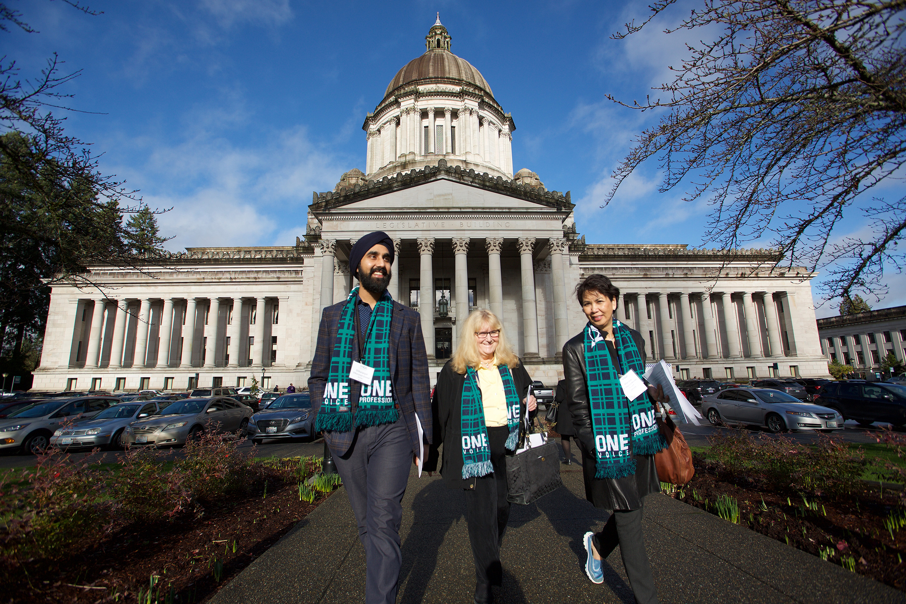
Dental Action Day 2016
Olympia, Washington
January

Slide 8
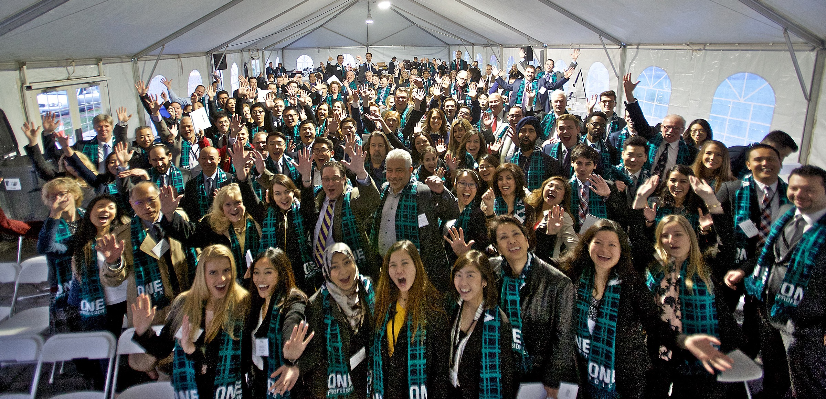

Slide 9
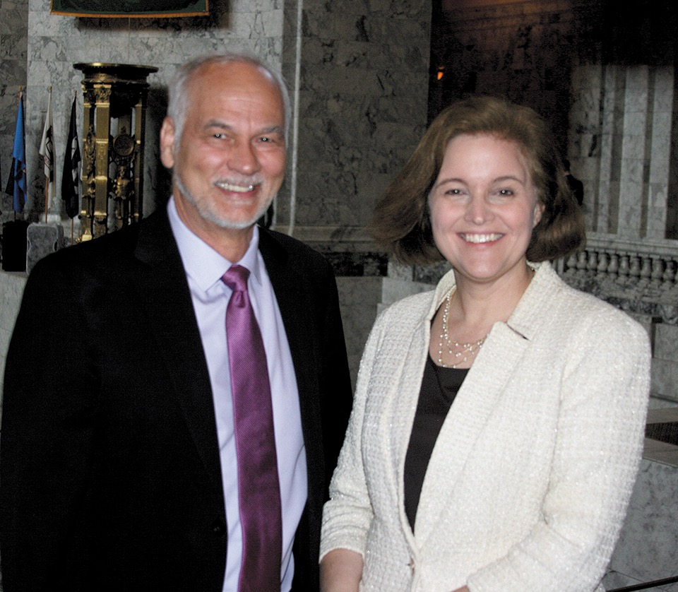
May 2016

Slide 10
House of Delegates
October 2016
HD-**-2016 Expansion of the ABCD Program
Background Statement: The ongoing success of the ABCD program indicates that if extended to children with special needs there would likely be an increase in their access to dental care. Patients who qualify as Developmentally Disabled (DD) are often unable to outgrow their inability to cooperate in a dental setting. This makes it challenging for DD patients to find a dental provider willing to see them, especially at such low reimbursement rates. Allowing providers to receive the ABCD reimbursement rate for this special population will encourage greater provider participation, thus increasing the number of dental providers DD patients are able to see in Washington state.
The Kitsap County Dental Society presents to the 2016 WSDA House of Delegates the following resolution:
RESOLVED, children who have been identified as having medical, physical, emotional or psychological disabilities past the age of 5 should still be eligible for the ABCD program, and the providers who treat them should be eligible for ABCD reimbursement rates.
end

Slide 11
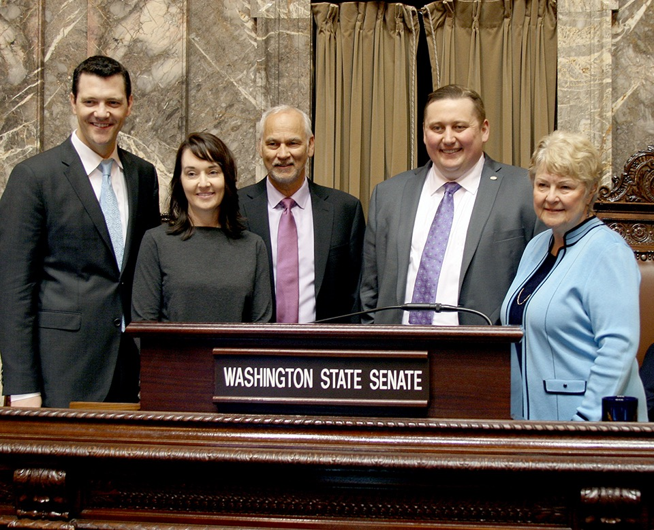
March 2017

Slide 12
Dental Action Day January 2017
Poulsbo Coffee Shop September 2017
Bill written November 2017
Testify before the State Senate Health & Long Care Committee January 2018
Testify before the House Health Care Committee February 2018

Slide 13
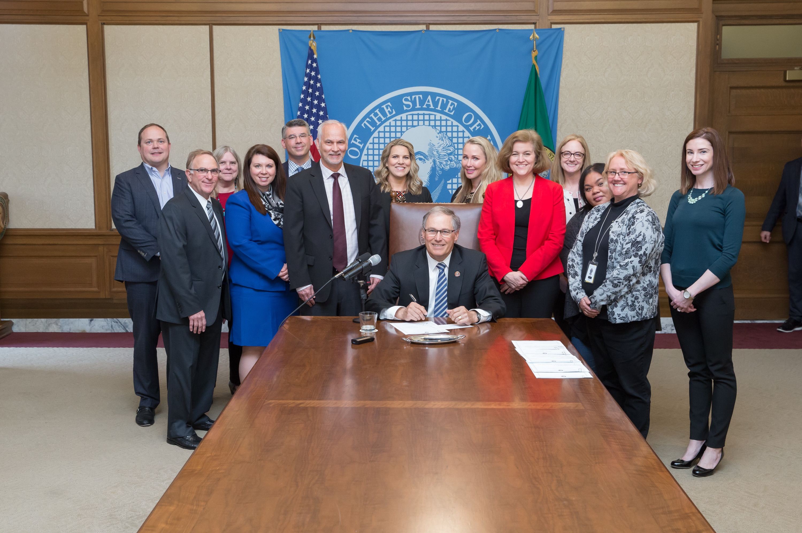
March 2018 signed by Governor

Slide 14
Thank you !
Questions ?
jkagib@comcast.net

