Slide 1
Logos, E Newsletters, Social Media, & Websites
Your Guide to the Digital AAPD

Slide 2
Using the AAPD Logo

Slide 3


Slide 4
Using the AAPD Logo
The AAPD allows the use of the AAPD logo by active and life members in good standing, as well as recognized chapter organizations such as state or provincial units and district organizations.
The logo may be used on:
Professional stationery
Letterheads
Business and referral cards and forms
Practice promotional materials (including direct mailers to families)
Interior and exterior doors and windows only, in AAPD member offices (limited to the member categories noted above)
Plaques hung in offices
Patient educational literature (so long as consistent with AAPD policies and guidelines)
Yellow pages print and electronic advertisements (active and life members should utilize the AAPD-endorsed Yellow pages service)
Web sites

Slide 5
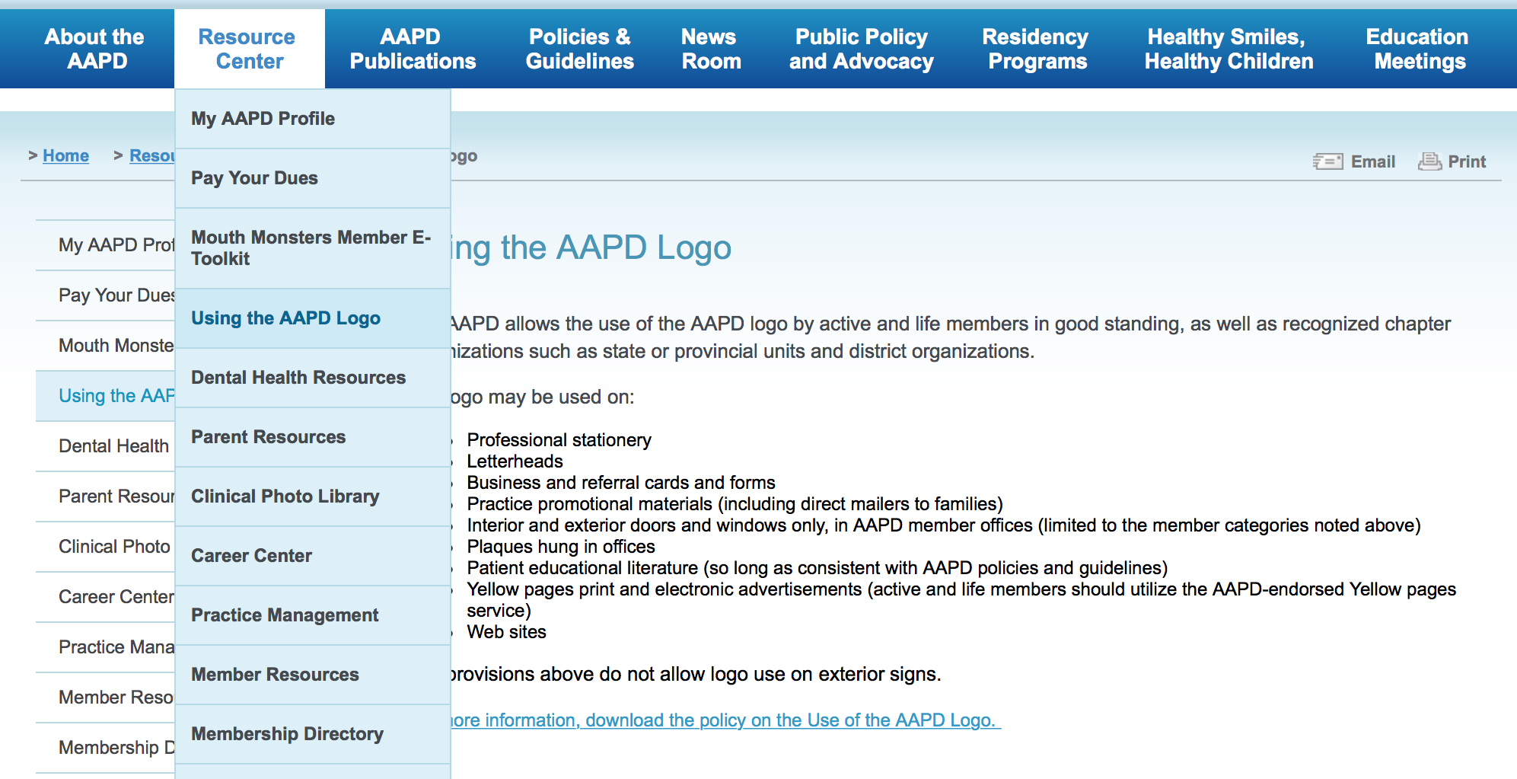
Using the AAPD Logo

Slide 6
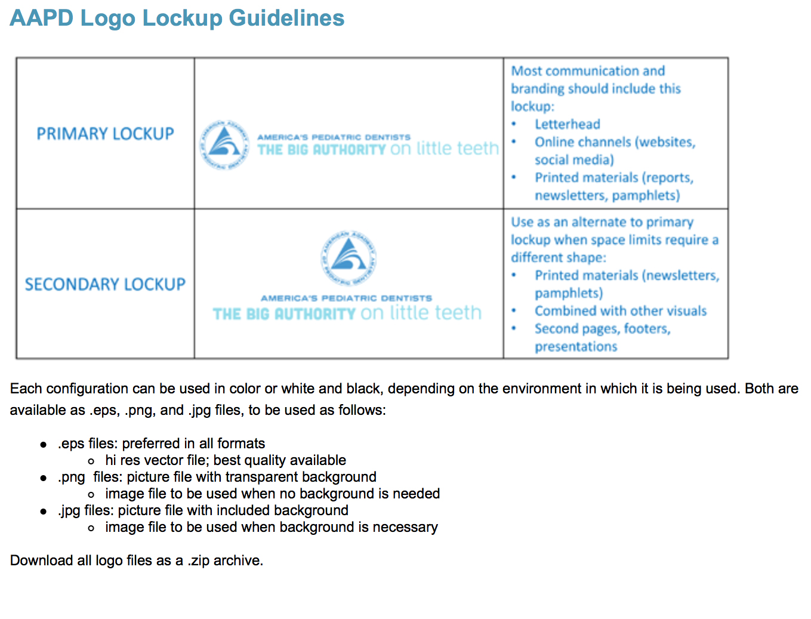
Using the AAPD Logo

Slide 7

Using the AAPD Logo
District and state unit organizations may utilize separate logos that indicate their specific name, provided such logos are approved by the AAPD board of trustees and do not conflict with the AAPD logo in terms of design and color scheme.
Active Member
Southeastern District
Tennessee Chapter

Slide 8

Using the AAPD Logo

Slide 9
AAPD E Newsletters

Slide 10
District and State Chapters, do you have an AAPD-approved meeting or CE Course you’d like to promote?
AAPD can include these in our bi-monthly E-News. AAPD will also add these under the event section of the AAPD website.
AAPD Headquarters can prepare and send a quarterly District e-newsletter at the request of District leadership. District leaders can gather stories and information and quarterly send to AAPD and we will format and send to members in your district. If this is something you are interested in, contact Web and Social Media Coordinator Lily Snyder to set up your e-newsletter schedule today.
lsnyder@aapd.org
AAPD E Newsletters

Slide 11
Social Media

Slide 12

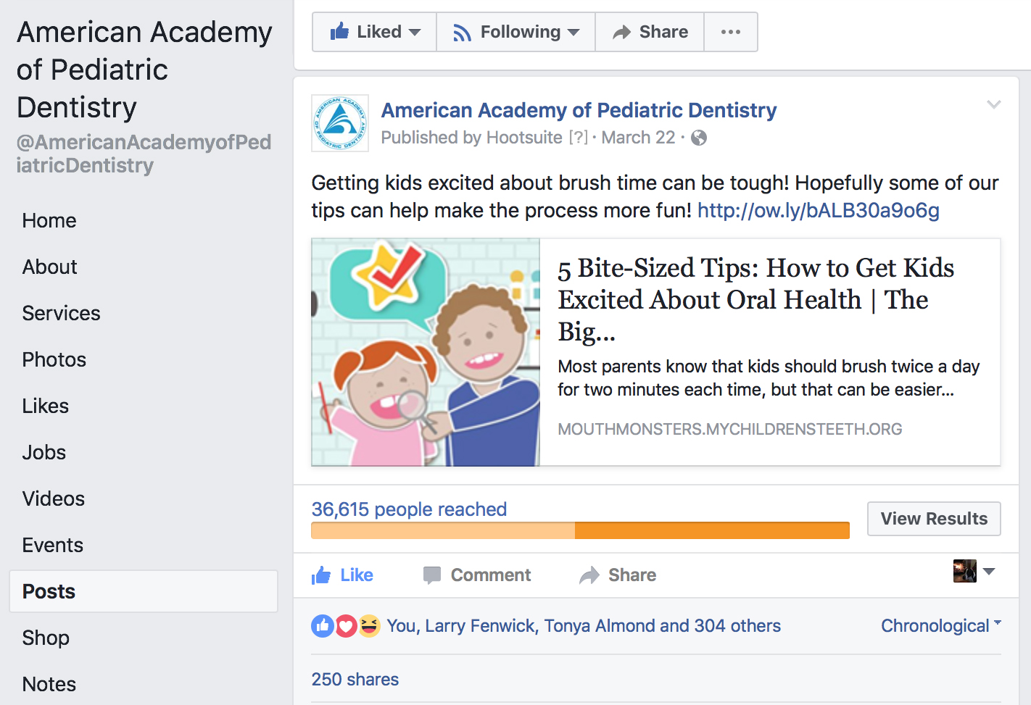
Follow the AAPD consumer Facebook page where you can learn and share AAPD tips and tricks to good oral health.
@AmericanAcademyofPediatricDentistry
Facebook Consumer

Slide 13
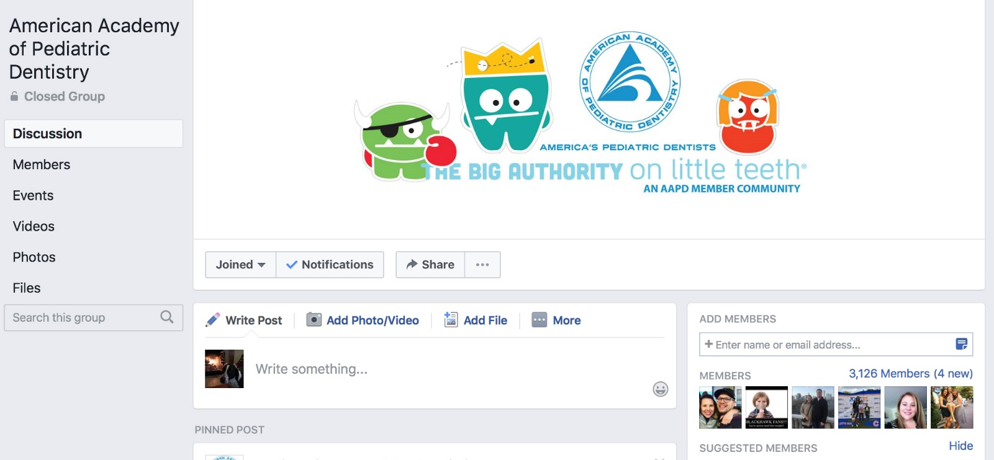
Members Only
Join our Closed Facebook Group where you can share:
Clinical Cases
Personal Experiences
Ideas for a Better Clinical Practice
Academic Research
Innovative Clinical Products
Relevant Events for Pediatric Dentistry
Facebook Group

Slide 14

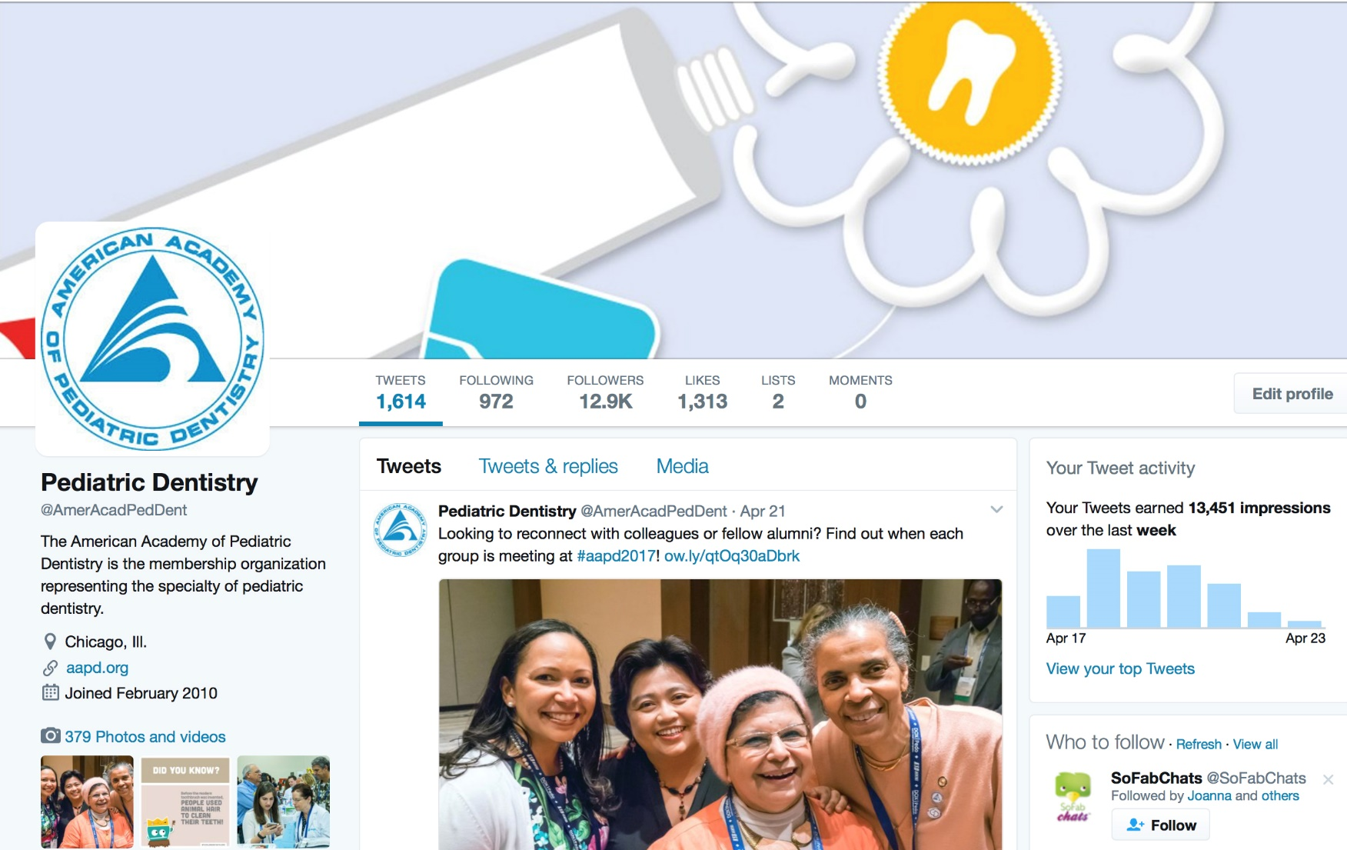
Twitter
@AmerAcadPedDent
Twitter

Slide 15
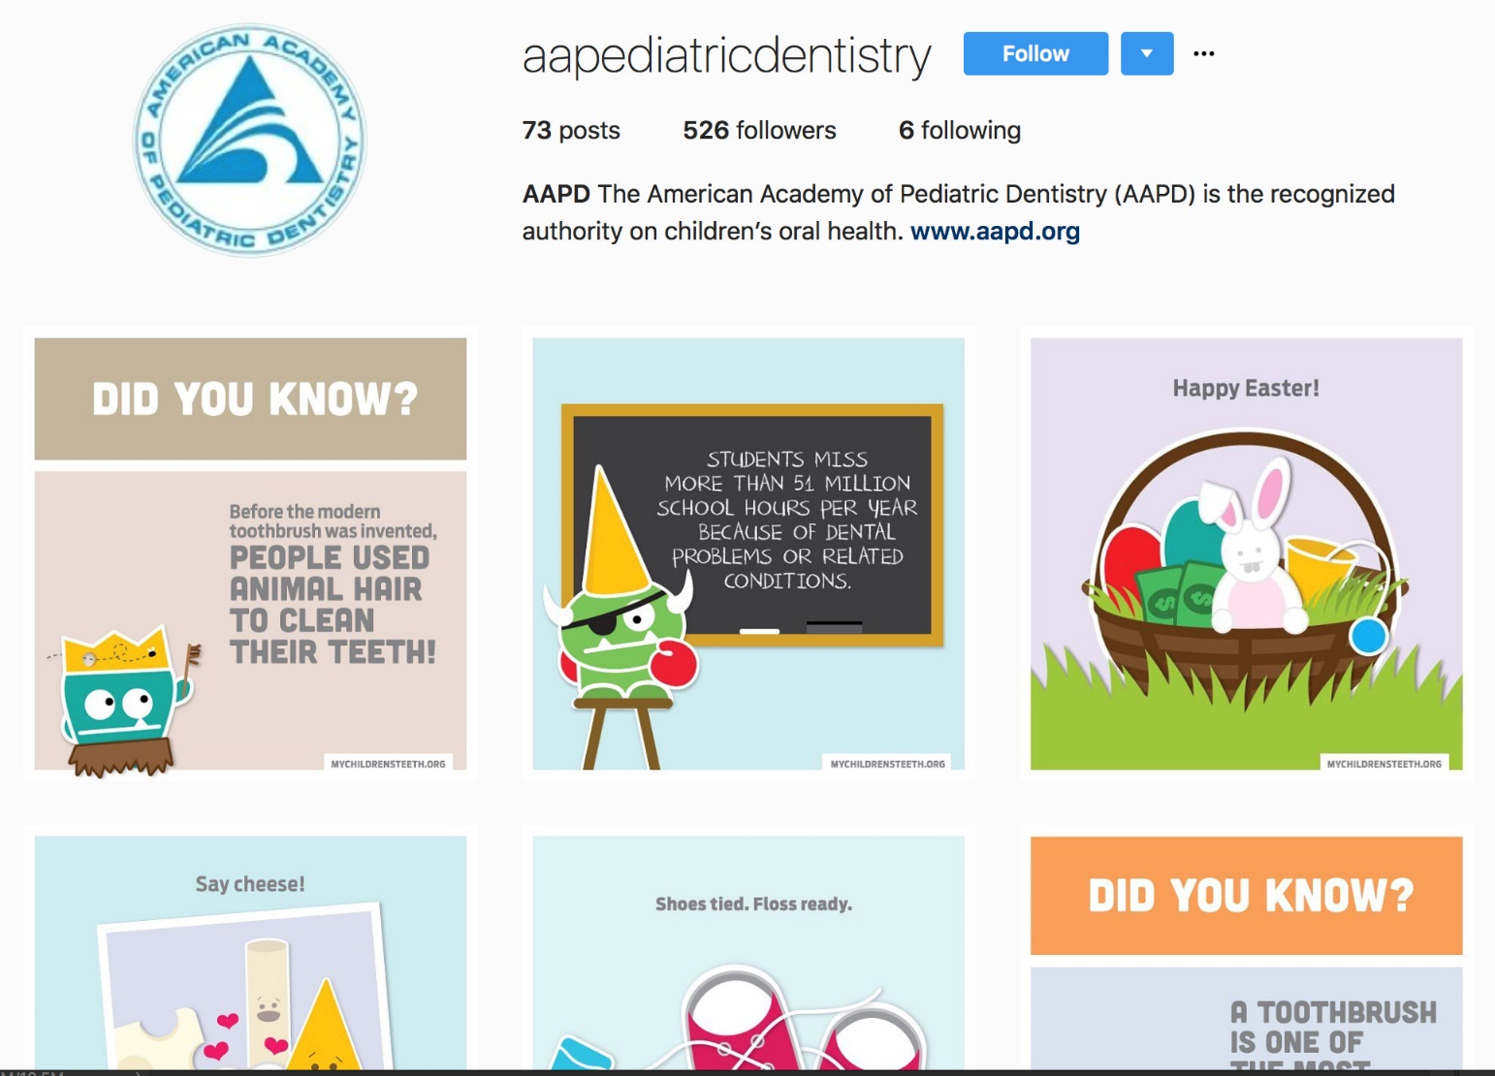
Instagram
aapediatricdentistry
Instagram

Slide 16
Visit Follow Like Share
The Digital AAPD

Slide 17
AAPD Websites

Slide 18
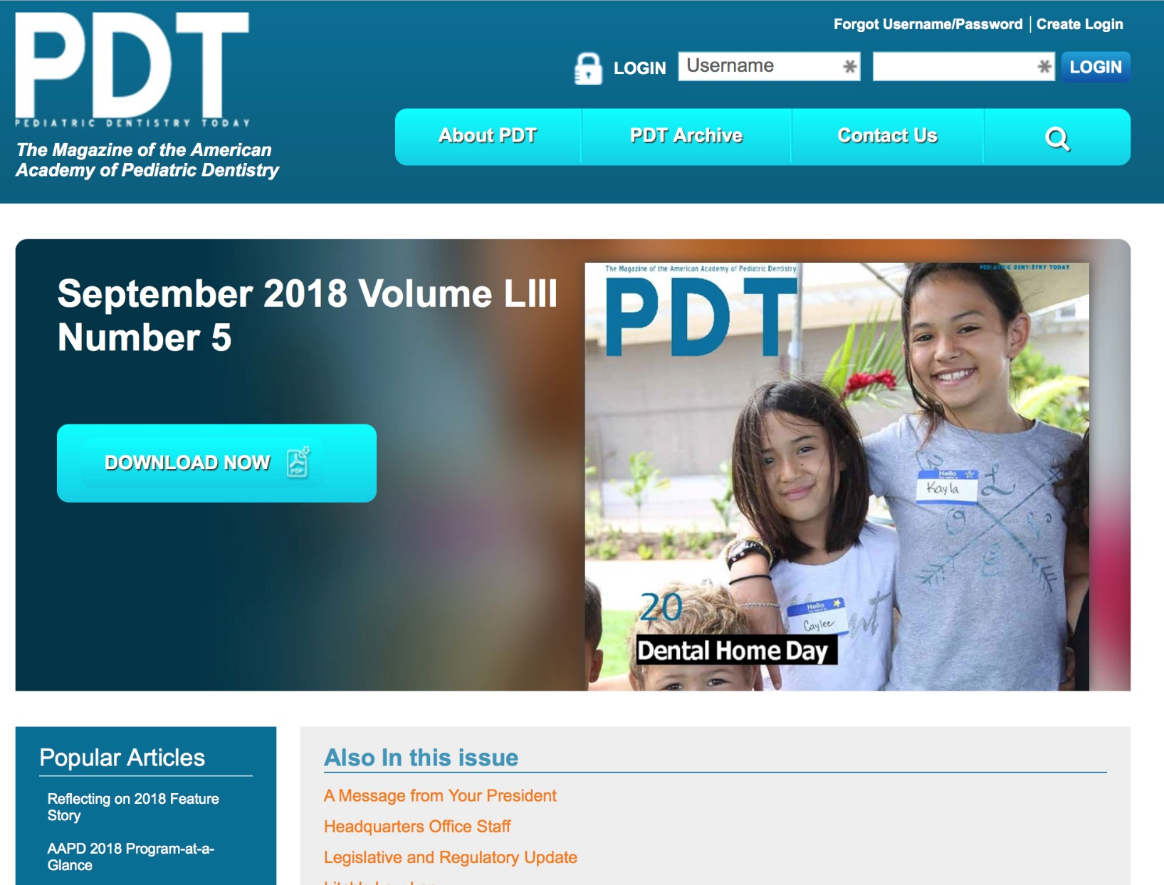
www.pediatricdentistrytoday.org

Slide 19
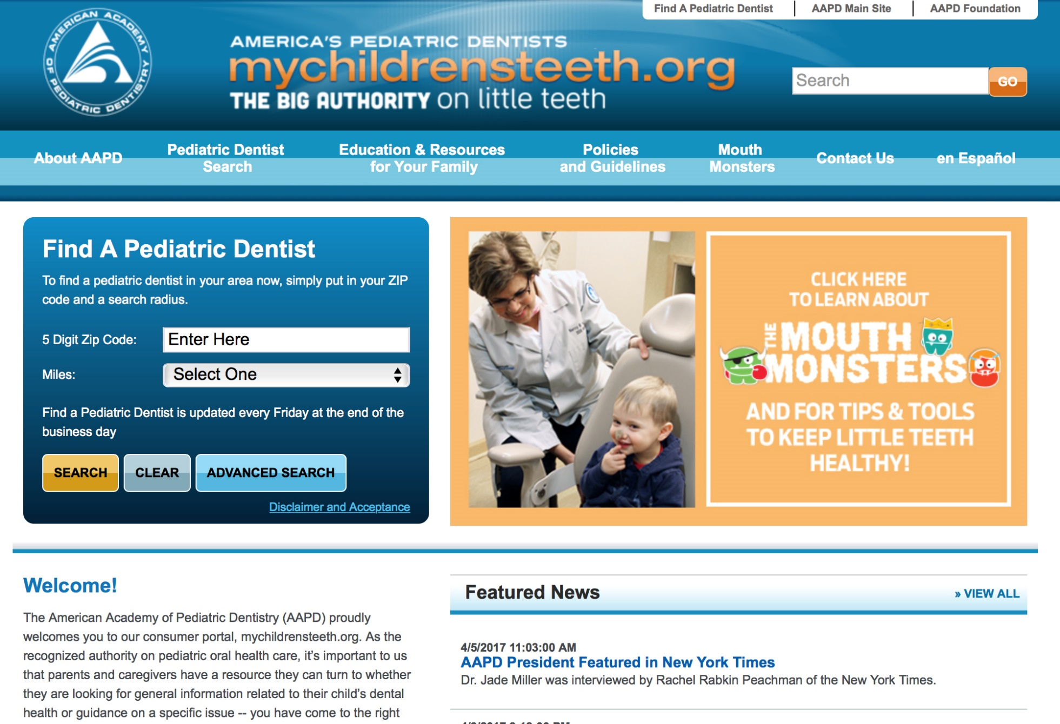
www.mychildrensteeth.org

Slide 20
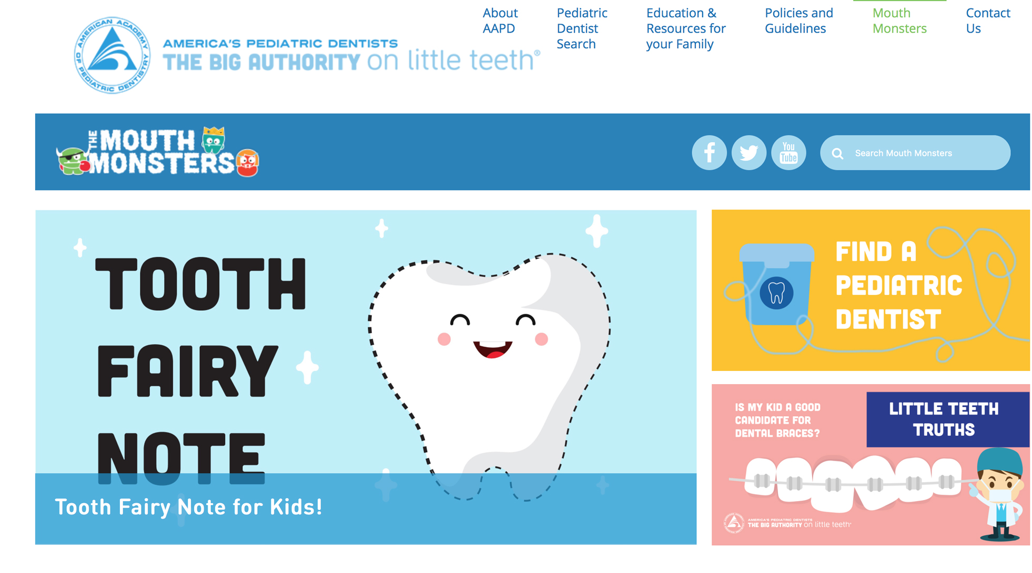
www.mychildrensteeth.org

Slide 21
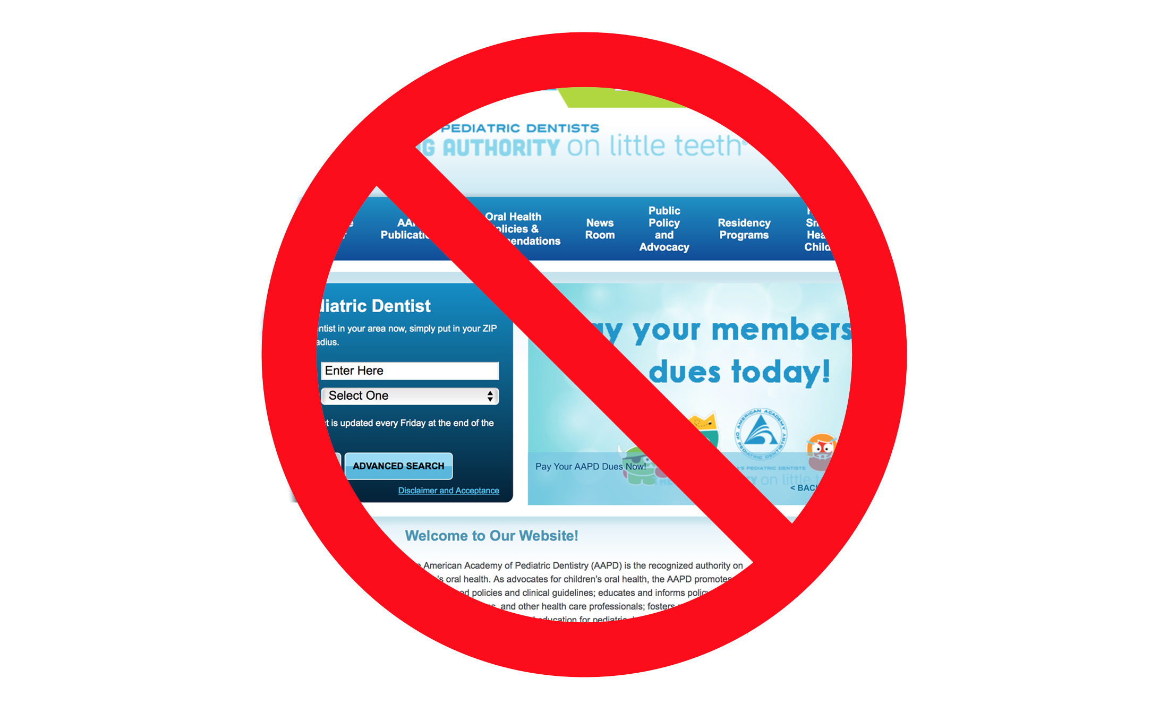
www.aapd.org

Slide 22

www.aapd.org

Slide 23
Thank you and stay tuned!

