Slide 2

Media Relations & Coordinating Responses with AAPD Erika Hoeft, PR Director: erika@aapd.org Dr. Robin Wright, Director, Pediatric Oral Health Research and Policy Center: rwright@aapd.org

Slide 3
Media Relations
Key Media Placements
Relationship with Weber Shandwick
How to work with Press

Slide 4
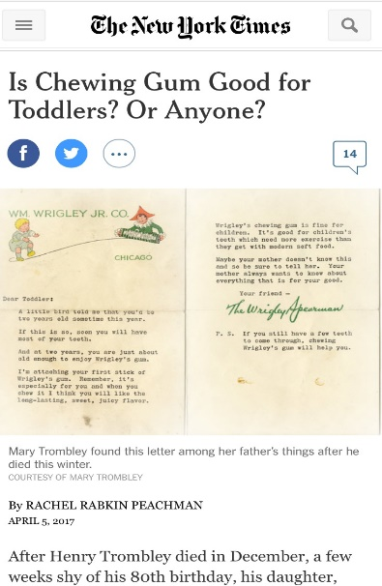
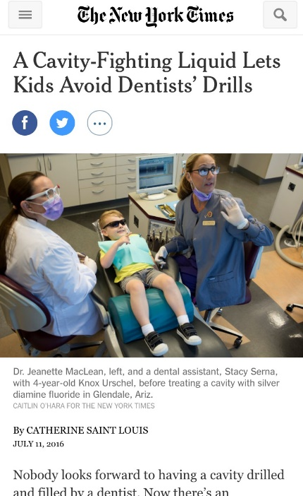
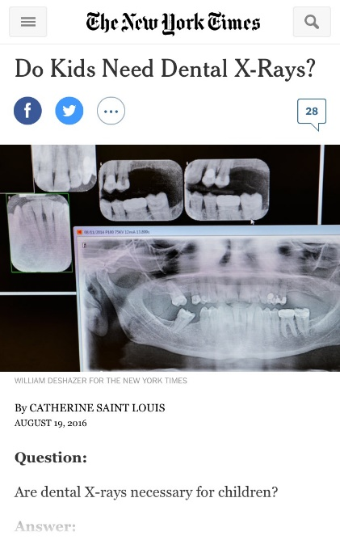
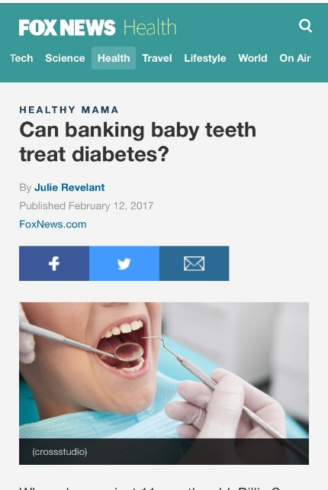
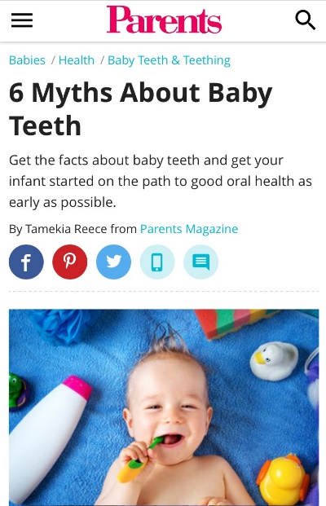
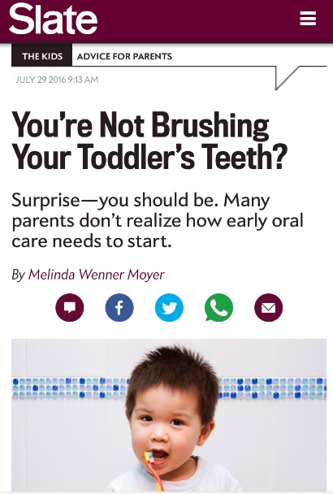
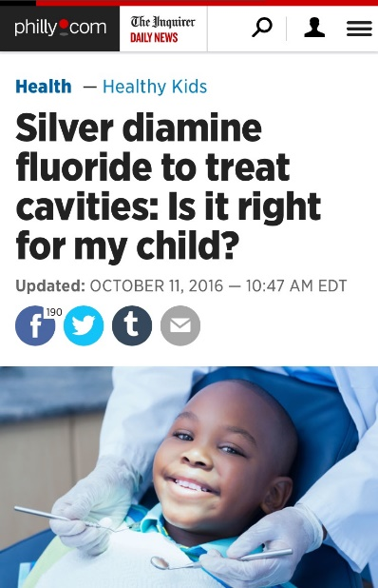
Key Media Placements

Slide 5
Weber Shandwick

Slide 6
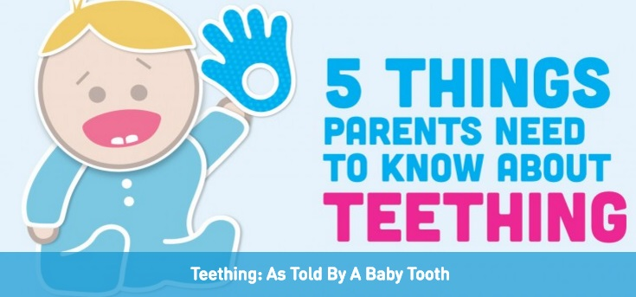
Weber Shandwick
Websites, Consumer Hub

Slide 7






NCDHM Satellite Media Tour
Results Snapshot
28 Spokesperson Interviews
382 Airings*
(including syndicated segments)
10.3 MILLION Viewers/readers reached
Nearly 100% of the interviews mentioned AAPD and/or drove to mychildrensteeth.org.

Slide 8



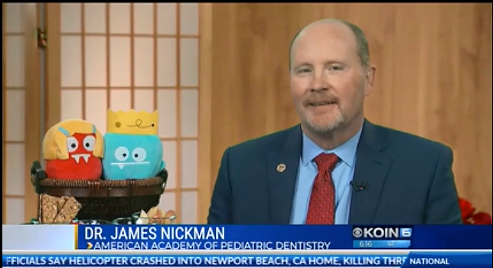
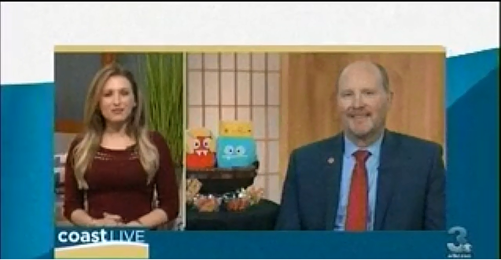

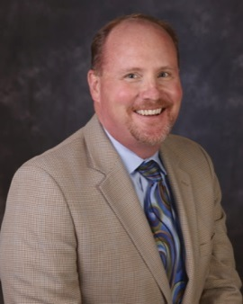
Coast-to-Coast Interviews Elevated AAPD & Pediatric Dentists
[Tooth decay] is entirely preventable. It mostly comes back to establishing good habits and routines within the family.
We spend a lot of time with families – [a dental home is] essentially an owner’s manual for their children.
Dr. James Nickman

Slide 9

Social Media 101: Toolkit

Slide 10

How to Work with Press
AAPD’s role internally when fielding media inquiries
Your role when contacted by press
How to work with the AAPD
Trained spokespersons in your area

Slide 11
How to Work with Press
Train your staff
Take your time
Check the outlet
Choose your messages
Plan your defense

Slide 12
How to Work with Press
Master the short answer
Tell a story
Stay on record
Don't guess

Slide 13

How to Face a Media Crisis

Slide 14
How to Face a Media Crisis
Check in with the AAPD
Don't speculate
Don’t say “no comment”

Slide 15
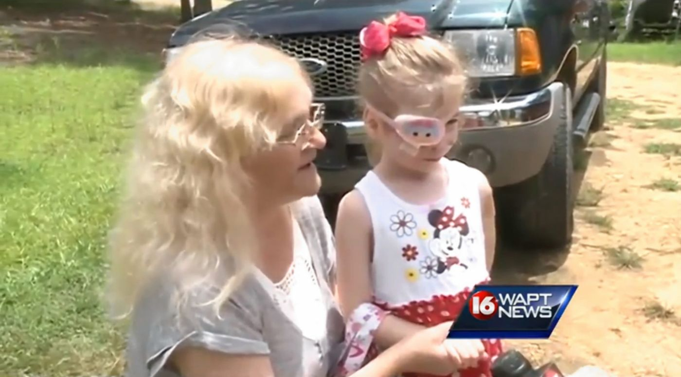
How to Face a Media Crisis

Slide 16
How to Face a Media Crisis
Don't minimize the crisis
Voice concern about the situation

Slide 17
How to Face a Media Crisis
Trust Determination – Low Anxiety
Competence/expertise 50
Caring/empathy 15-20
Honesty/openness 15-20
Dedication/commitment 15-20

Slide 18
How to Face a Media Crisis
Trust Determination – High Anxiety
Competence/expertise 15-20
Caring/empathy 50
Honesty/openness 15-20
Dedication/commitment 15-20

Slide 19

How to Face a Media Crisis

Slide 20

How to Face a Media Crisis

Slide 21
How to Face a Media Crisis
Don't minimize the crisis
Voice concern about the situation
Stress your commitment

Slide 22

Top Questions for 2018

Slide 23
Resources
Mouth Monster Hub:
mouthmonsters.mychildrensteeth.org
AAPD Consumer Facebook:
AmericanAcademyofPediatricDentistry
AAPD Twitter:
@ameracadpeddent

Slide 24
Media Relations

