Slide 1
SDF: Medicaid and Other 3rd Party Coverage
Jeff Kahl – PPA for Colorado

Slide 2
SDF Policy/Benefit Considerations
Considerations and Science – as it applies to benefit design and policy
Scope of Care and Access.
Policy and Benefit Process in Colorado

Slide 3
Challenges in Benefit Design
Relative newness means that there isn’t a lot of research or data.
From an evidence based standpoint the research available is low-quality.
Multiple popular protocols with some variance.

Slide 4
Benefits of SDF
Cost of managing severe early childhood caries is disproportionately high.
Dental surgery rates are much higher in less affluent populations (25.7 vs 6.9 per 1000)
Decrease need for treatment under sedation or general anesthesia.
Decrease need for more costly restorative procedures.

Slide 5
Benefits of SDF
Adult Populations
Many of the same treatment challenges/benefits exist especially for patients with special needs and patients in long term care facilities.

Slide 6
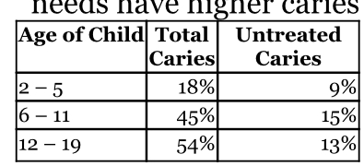
Other Considerations
How many patients will utilize the benefit?
National Untreated Caries Rates in Children
Acceptance around 20%

Slide 7
Other Considerations
How many teeth are treated at one time?
No current data because of relative newness.
Manufacturer recommends no more than 5 teeth.
How many teeth need restorative treatment or extraction later?
No current data because of newness.

Slide 8
AAPD Guideline
AAPD supports the use of 38% SDF as part of a comprehensive caries management program.
The recommendation is conditional based on low-quality evidence.
Pooled evidence suggests:
68% of lesions would be expected to be arrested 24 months after one to two applications.
Reapplication 1-3 months later may be required to fully arrest lesion.
Biannual application higher arrest rates than annual.
50 % of arrested lesions reverted to active lesions at 24 months.
Annual reapplication required to maintain arrested lesions.

Slide 9

What is Ideal?

Slide 10
From a Practical Standpoint
Billed Per tooth.
Benefit would allow for.
At least 1-2 applications/year
Reimbursement?
Needs to be reasonable.
More applications better.

Slide 11
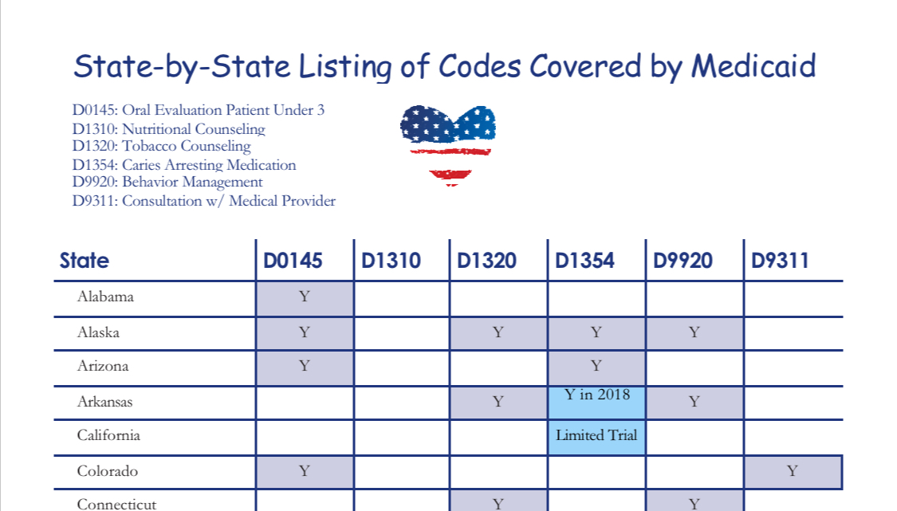
States With SDF Medicaid Coverage
As of June 2018 – 27 states had some coverage for D1354

Slide 12
Variation in Coverage
Only Pediatric Patients
Adults and Children
Only Children under 5
Limit 1 or 2 times per year
Cap of 2, 4, or 6 applications

Slide 13
Florida Medicaid
$6.44 per application/tooth
2 applications per year

Slide 14
Kentucky Medicaid
$25 per application per quadrant
2 applications per year

Slide 15
Virginia Medicaid
$32.28 per application/tooth
2 applications per lifetime
2nd application no less than 90 days later.
If restorative/endo/ext of treated tooth is done within 180 days. That fee will be reduced by $32.28.

Slide 16
Commercial Benefits
Metlife - $17
1 application per tooth in 60 months
Aetna Plus - $80
Posterior permanent teeth only
1 application/quadrant per 36 months.
UCCI - $3.97
1 per tooth every 36 months.
Some Deltas - $27-31
2 applications/year

Slide 17
Scope of Care/Access to Care
Goals of your delivery system
Not just to reduce or prevent disease but to bring children who aren’t otherwise engaged into the dental delivery system.
Coordination and communication allows for more appropriate migration of patients across spectrum of the delivery system.

Slide 18
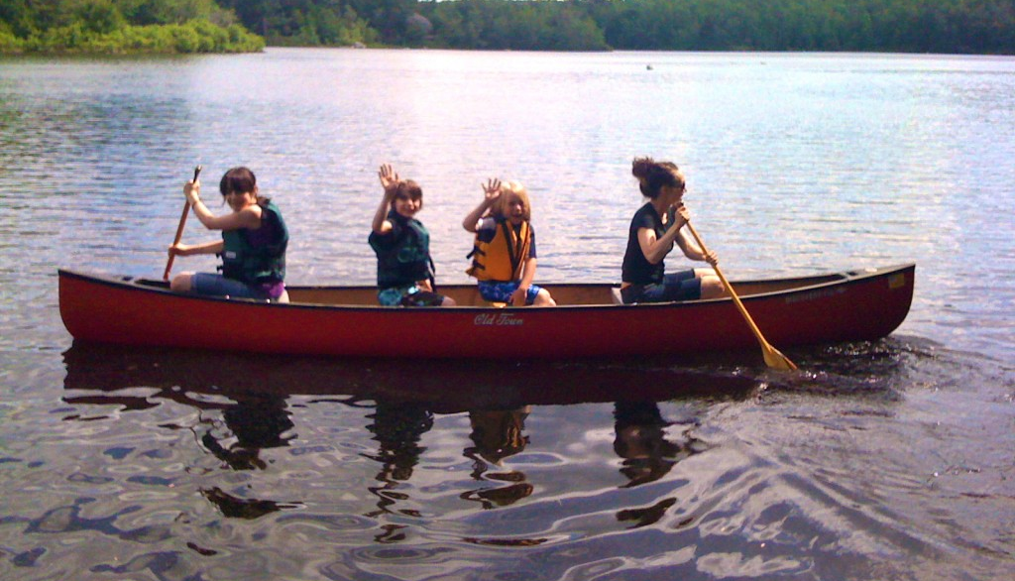
Scope of Care/Access to Care

Slide 19
Scope of Care/Access to Care
How Does SDF fit into the Dental Delivery System?
School Based Care/VDH
Dental Office or Mobile Clinic
Sedation,
General Anesthesia
School Screening

Slide 20
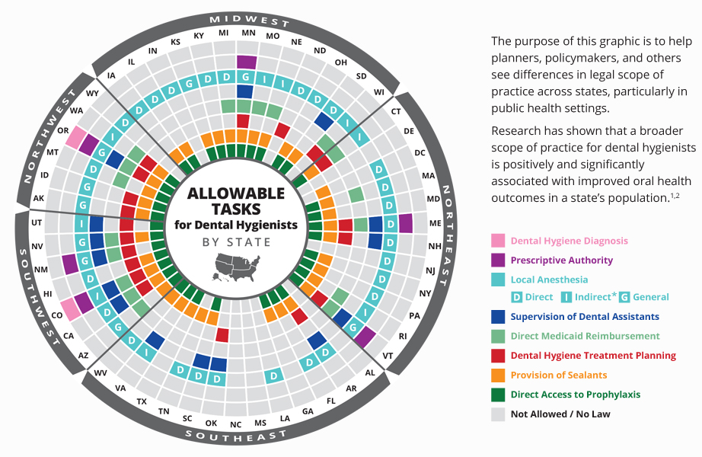

Slide 21
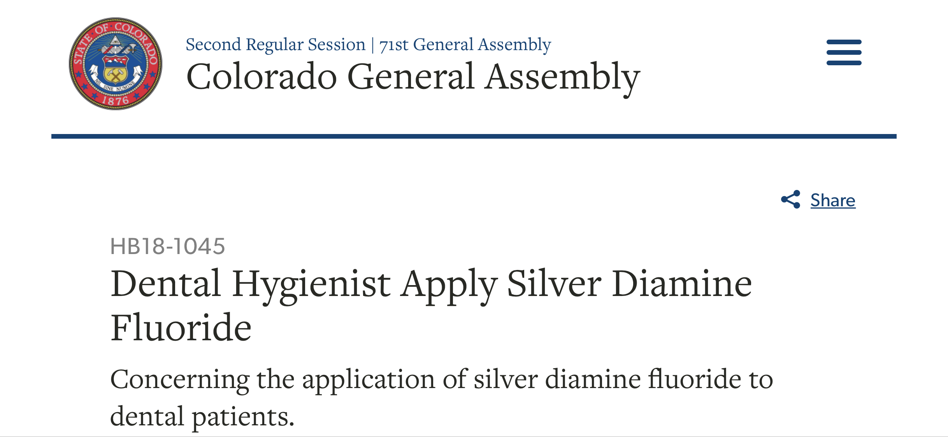

Slide 22
HB - 1045
Allows dental hygienists to apply silver diamine fluoride under the direct or indirect supervision of a dentist
Hold a license in good standing
Completes a course on the use and limitations of SDF
Is covered by professional liability insurance
Has a collaborative agreement with a dentist that describes the SDF protocols, any restrictions or limitations, and follow-up referral mechanisms.

Slide 23
How Did this Get Done in Colorado?
Patience
Unified stakeholder group
Good relationship with department of healthcare policy and finance.
Pre-session work to educate legislators and bill sponsors.
The Dental Board?

Slide 24
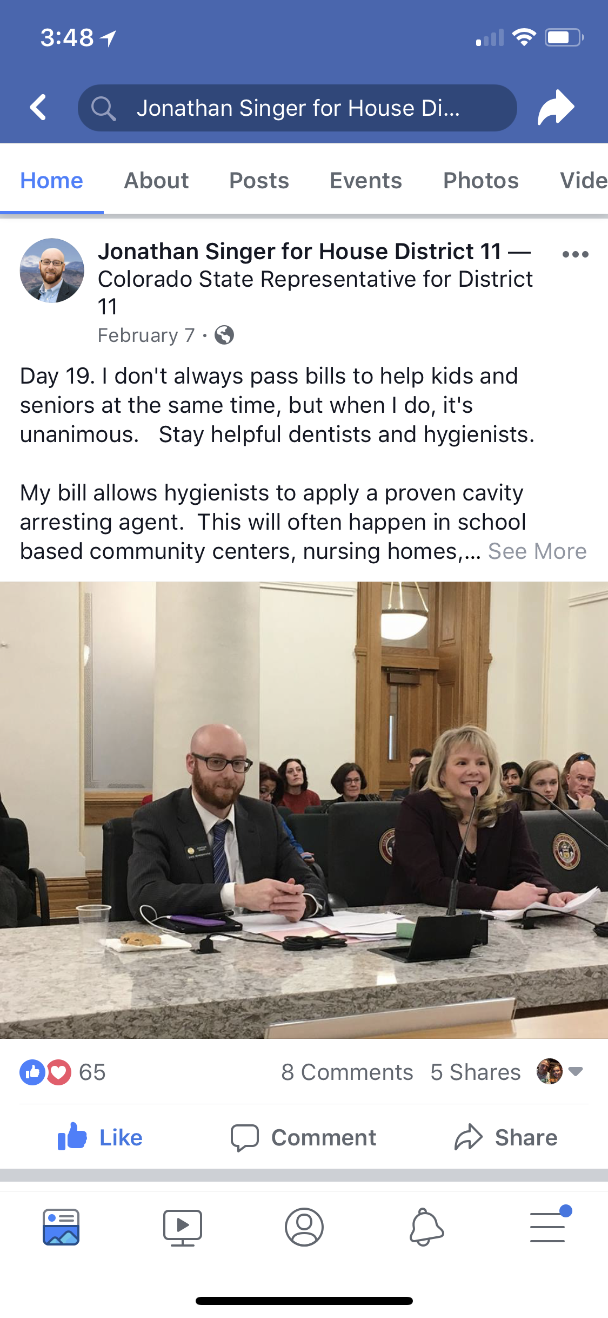

Slide 25
Colorado Medicaid Benefit
Live on Oct 1st
2 applications per tooth per year
Up to 4 applications per lifetime of tooth.
Reimbursement - $15-27

Slide 26
other insurance
The contract for the CHP Dental benefit is in RFP we are hoping to address D1354 coverage in that process.
Delta PPO in Colorado provides some coverage. We’re working on expanding that to other plans offered here.

Slide 27

Questions?

