Slide 1
Medicaid Issues: New Research for Medicaid Dental Advocacy
Public Policy Advocates Workshop, September 29, 2018
Beau Meyer, DDS, MPH
Public Policy Advocate—North Carolina Academy of Pediatric Dentistry
beau_meyer@unc.edu

Slide 2
Where are we?
Utilization is changing
  Contributors
Financing mechanisms
  Fee-for-service budgeting?
  Capitated budgeting?
Reimbursement mechanisms
  Future of fee-for-service?
  Managed Care?
  ACO’s?
  Value or quality metrics?

Slide 3
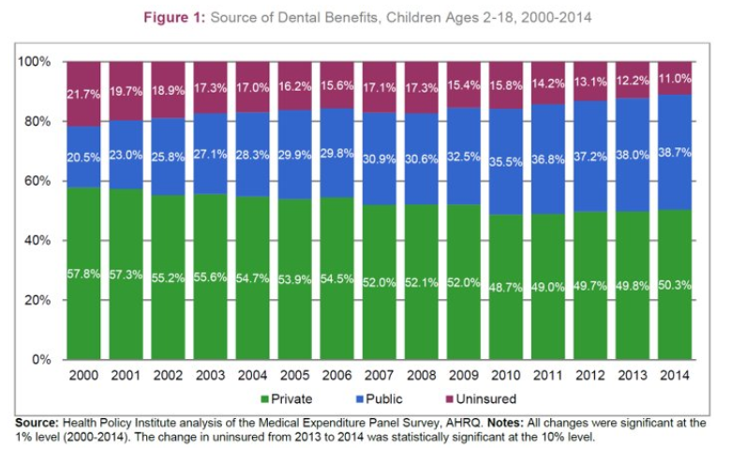
Sources of dental coverage
Notes:
Funding is usually a big player. About 40% of dental users are publicly insured.

Slide 4
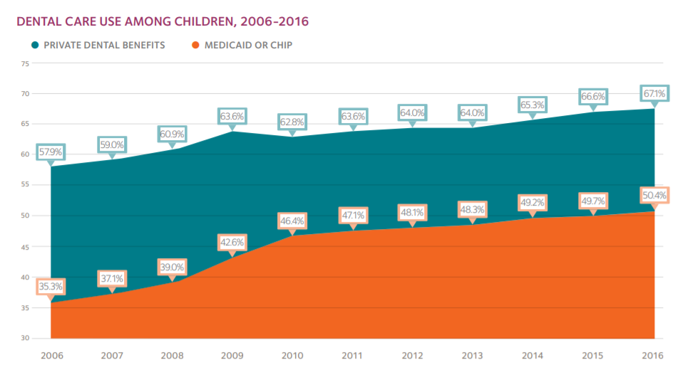
Dental utilization
Notes:
The gap is closing between Private and Medicaid patients. Lots of things happening, but possibilities: better reimbursement, more enrollment after the recession that has maintained after the ACA, more providers available to see children

Slide 5
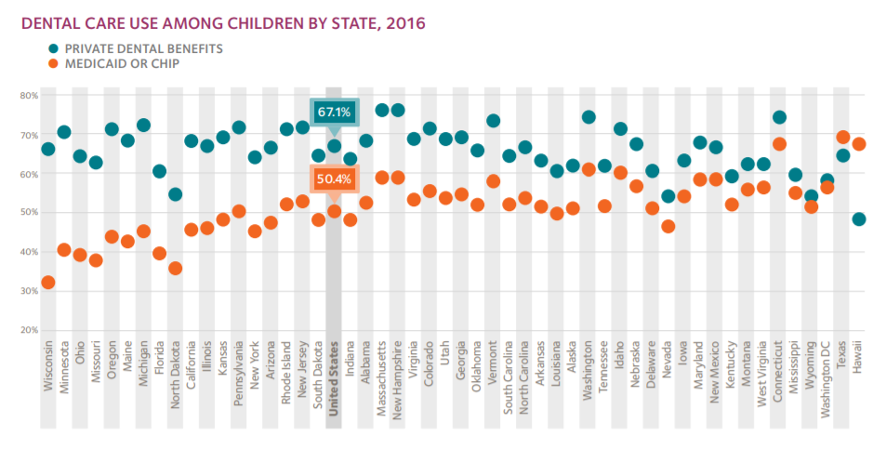
Variability by state
Notes:
But there is still a lot of work to do in some states. Some have very good programs with very high utilization rates. Others need a little work.

Slide 6
Lower disease rates

Slide 7
Overall healthcare financing
Notes:
Total dental expenditures were $124B in 2016, a 3.3% increase.
Dental expenditures make up about 4% of the overall health care market.
An increasing component of the dental expenditures is Medicaid.

Slide 8
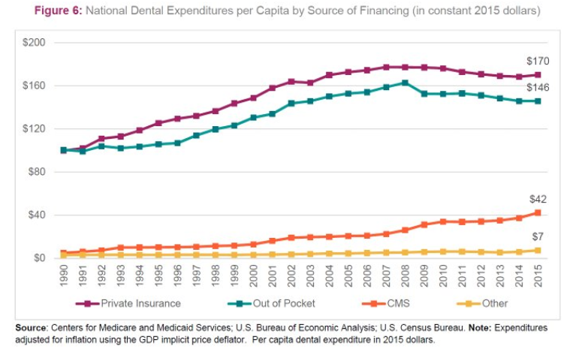
Dental expenditures per person
Notes:
Per capita Medicaid expenditures are markedly increasing, but are still only about 25% of private insurance at the individual level.

Slide 9
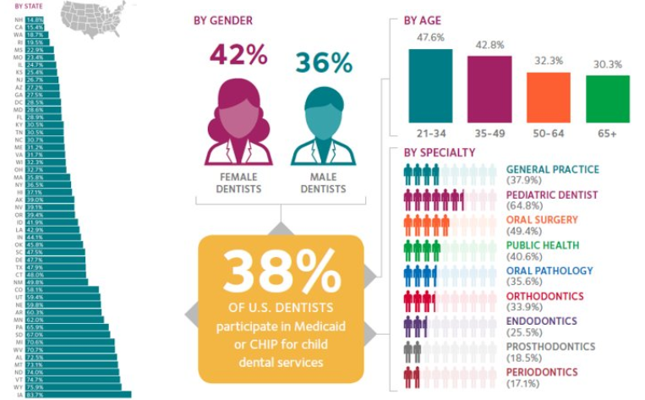
Provider participation
Notes:
Marked variation across the US in terms of participation. But it is encouraging that young graduates are participating, and that 2/3 of pediatric dentists participate

Slide 10
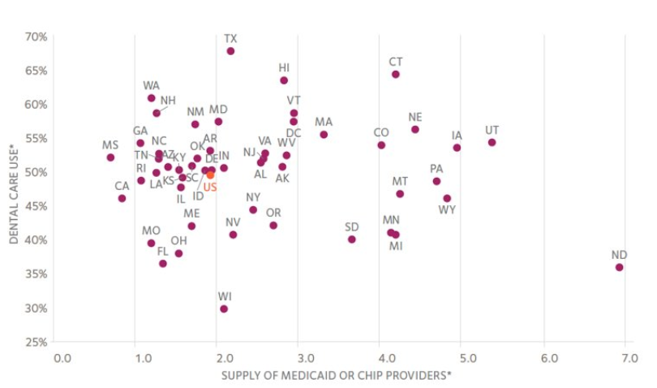
Provider participation vs. utilization
Notes:
But, there is no relationship between Medicaid participation and beneficiary utilization.

Slide 11
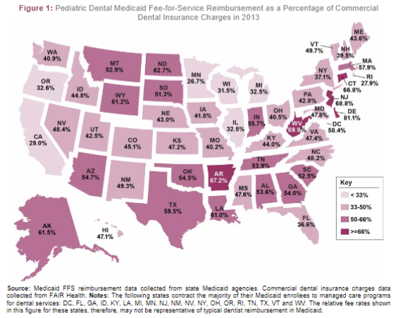
Medicaid reimbursement
Notes:
So what does influence utilization? Increasing reimbursements seem to work. As a whole, Medicaid reimbursement is less than 50% of commercial dental insurance plans, which are less than the providers fee schedule.

Slide 12
Medicaid reimbursement

Slide 13
Reimbursement vs. utilization
Notes:
A quick, simple display of data from the ADA HPI shows a small relationship between reimbursement rate and utilization rate. But what do more sophisticated analyses show?

Slide 14
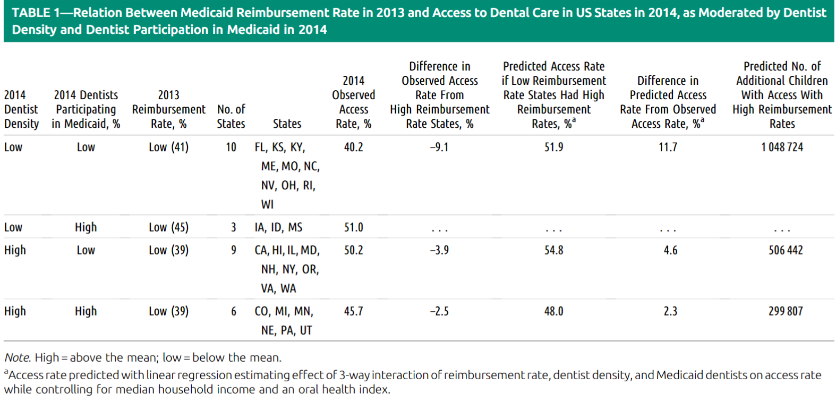
Putting it all together
Notes:
In states with low dentist density and low numbers participating in Medicaid, increasing the reimbursement rates is expected to dramatically improve utilization rates.
In highly dense areas and in areas where participation is already high, increasing the reimbursement rate would have little effect.
If highly dense areas have low participation, increasing reimbursement would have modest effects.

Slide 15
What about managed care?
ADA HPI data (not up to date)
  Not promising
  Nearly 20 states reported contracts
    6 experienced lower utilization
    5 maintained utilization
    Remaining increased utilization by small percentage points

Slide 16
What about managed care?
Reimbursement to providers might make a difference
  Some managed care contracts are still paying providers fee-for-service
Still unclear how quality metrics will impact provider reimbursement
  Problems with metrics—definitions, limitations
    Lead article in JADA September 2018 suggests that the claims-based metrics may underestimate care and that clinical/EHR data must be considered
  Unclear reimbursement applications to dentistry

Slide 17
How can we use this?
The numbers point us in the right direction
Active engagement in state’s MCO contracting
  MCO’s can still pay dentists on a fee-for- service basis
The dial is moving forward only where fees are in the market-place range
  We know of no examples where states slashed rates and provider participation increased, patient utilization increased, and children’s oral health improved
Personal stories from patients make compelling cases
  Unfortunately, stories from providers do not

Slide 18
Thank you

