Slide 1
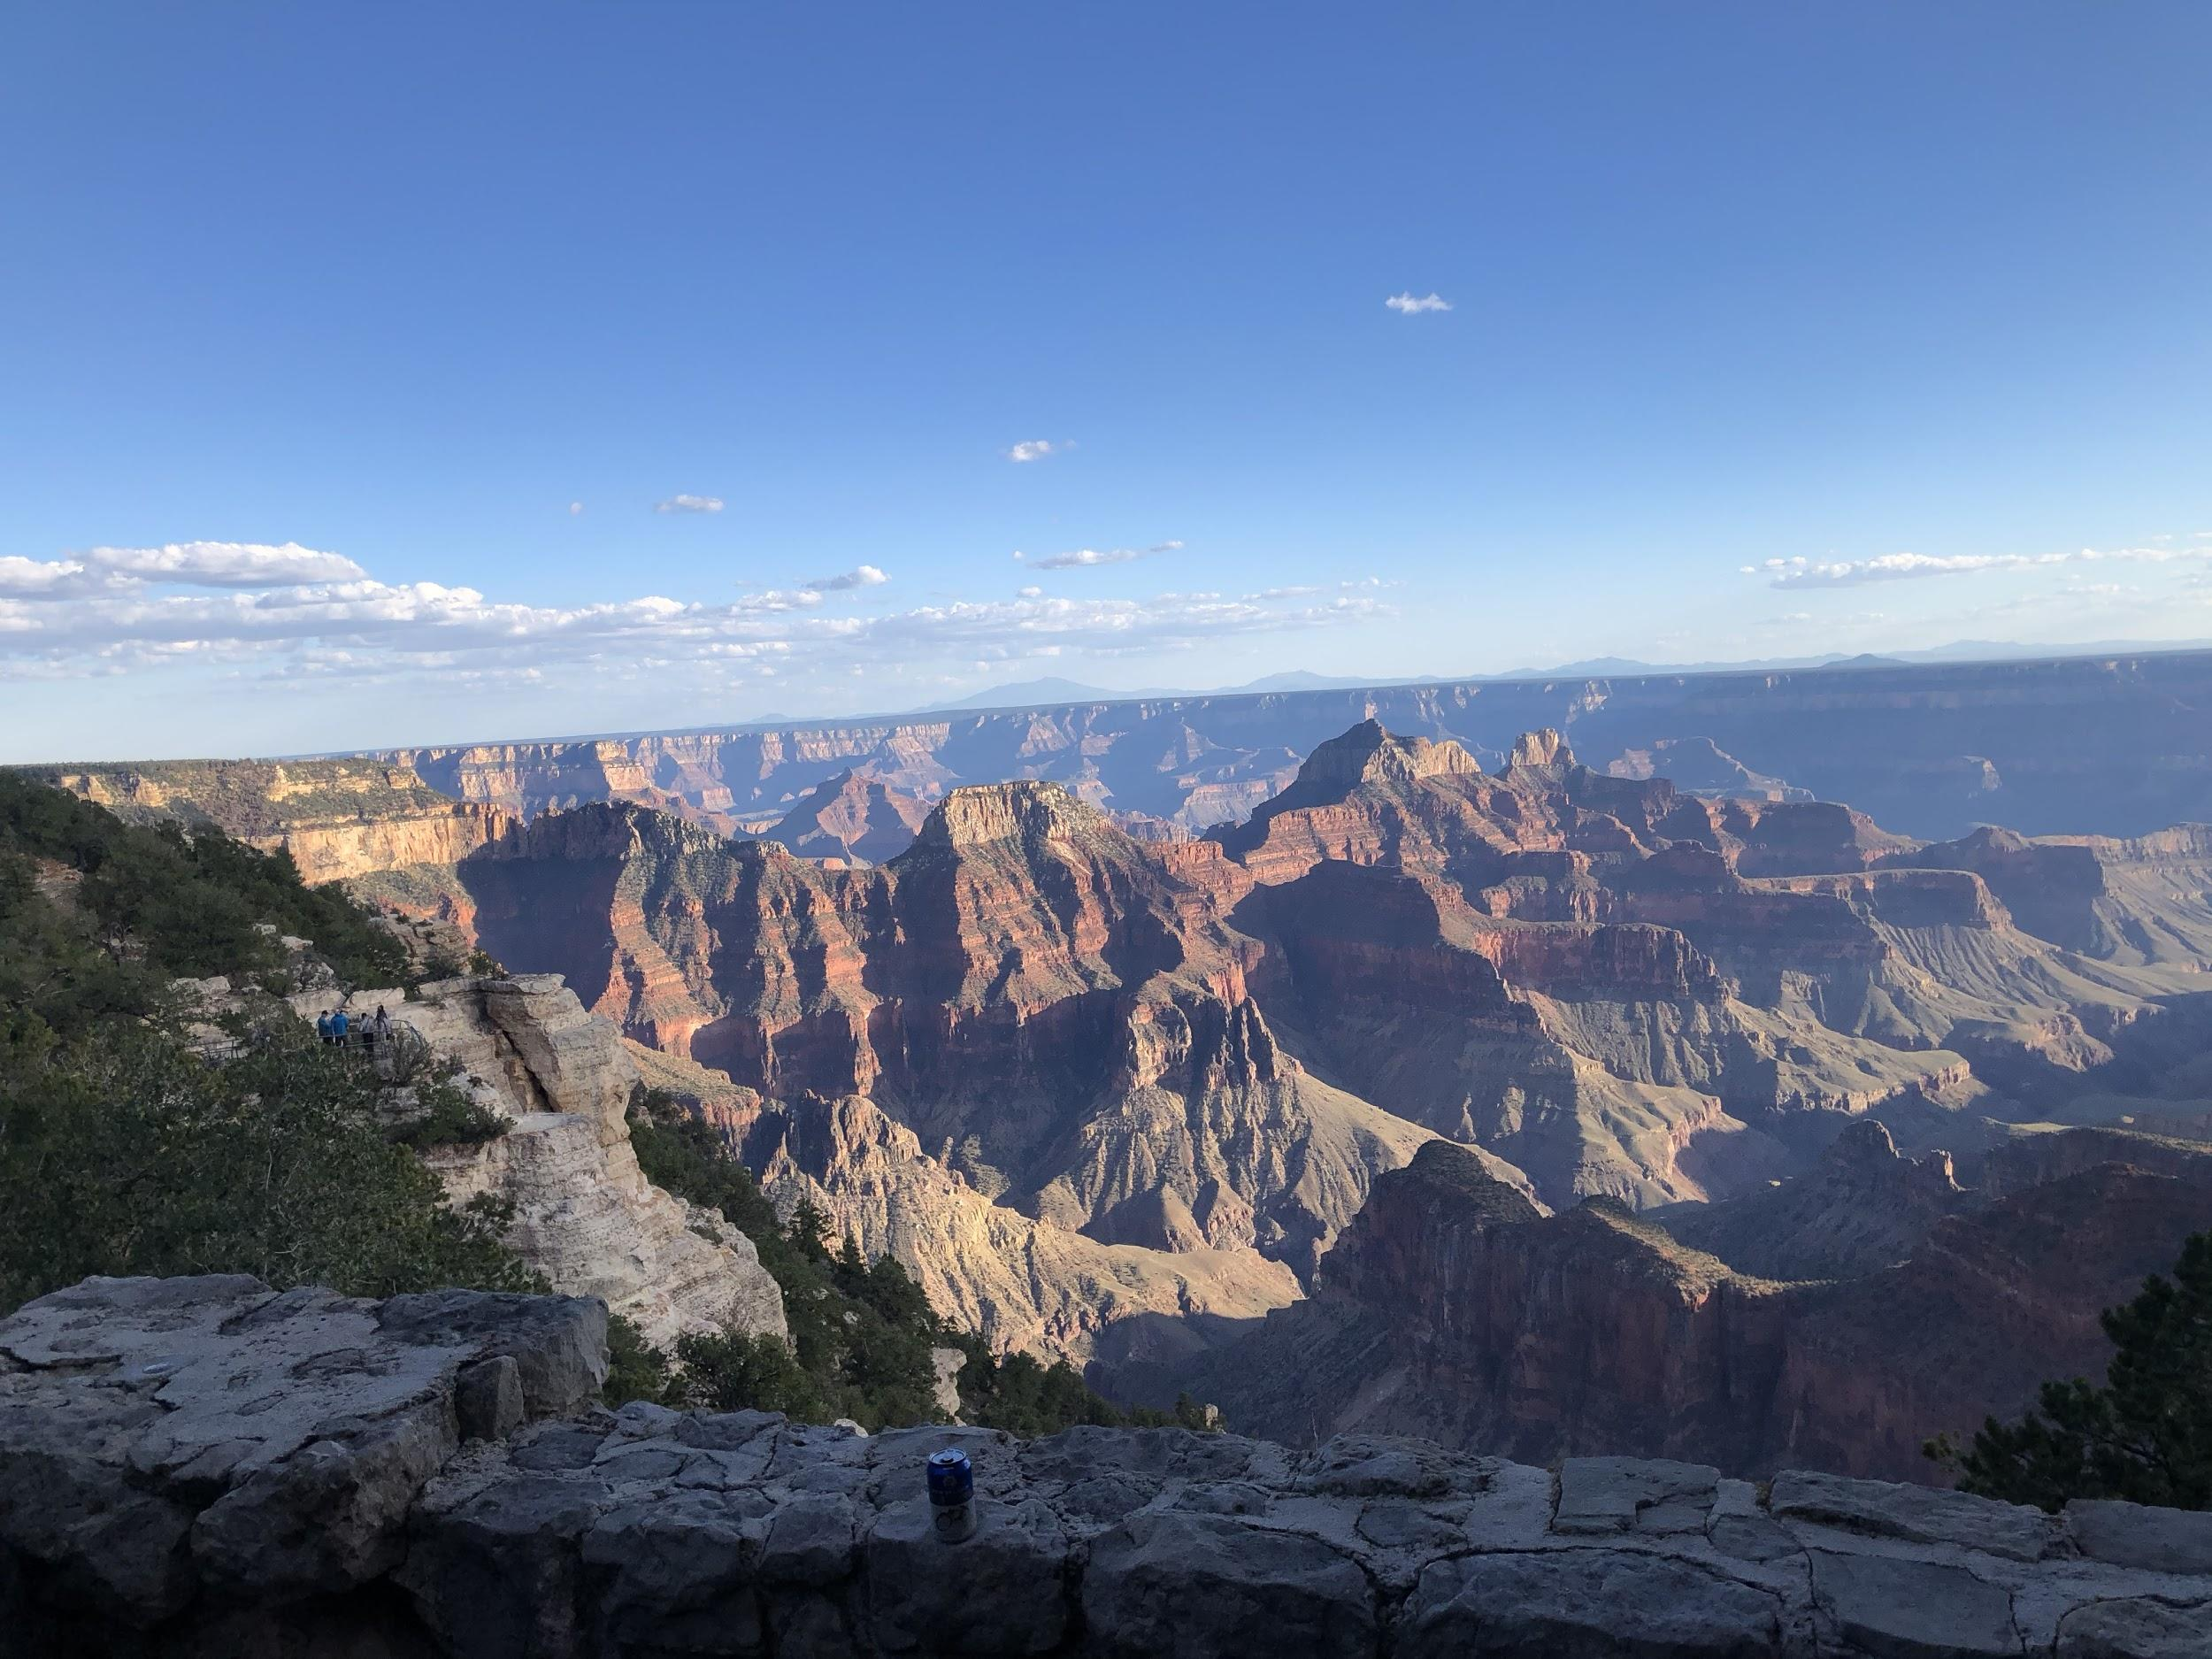
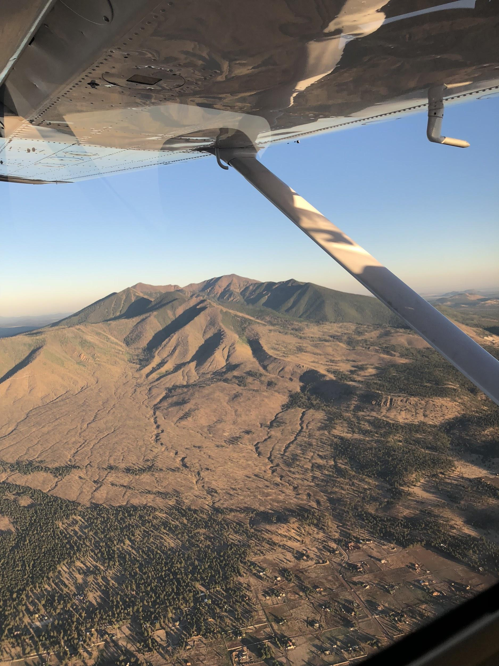
Dental Therapy Rollercoaster in Arizona

Slide 2
Timeline
November 28th, Health Committee Reference Meeting (Sunset application hearing)
Passed committee by one vote, in 2016 it did not pass by more than a majority vote
Hearing lasted over 5 hours with most of the time given to the proponents of the bill
Committee chair requested that the authors of the bill work together with the dental association, this never happened
Dental Therapy Bill introduced with 30 sponsors from a total 90 representatives in our state legislature
Dental Day at the Capitol 2/14/2018
AzCGA met seven times in addition to multiple conference calls and informal meetings, adjusting game plans
May 14th, 2018 - end of the legislative session

Slide 3
HB2235 Dental Therapy Sunrise
Initially introduced as SB1377 by Senator Barto and drafted by the PEW Foundation
Supported by a broad coalition of organizations ranging from liberal groups to conservative (Goldwater) and libertarian groups
Arizona was the 1st state where PEW used the support of conservative groups to promote and advocate that DT would be the “free market” answer to Arizona’s dental care issue
AzDA countered on multiple fronts and took every opportunity to weaken/lessen the impact of the legislation by amendment
supported by ADA SPA grant of $15K per month
Hired 2 additional lobbying firms in addition to AzDA’s lobbyist and a PR firm

Slide 4
SB1377
Expansive and proposed that any individual with pre-qualifications could complete a 3 year CODA accreditation dental therapy program, pass a WREB examination, and treat patients under general supervision after completing a 400 hour preceptorship under a licensed dentist.
Bill double assigned to education and health committees, passed both with close votes
Bill amended on house floor to require applicants to be a dental hygienist first and increasing the preceptorship to 1000 hours
Bill passed senate by a 22-8 vote and sent to the house
Heard in the house health committee with a 3 ½ hour hearing and was defeated by a 5-4 vote

Slide 5
Strike all bill, HB2235 Born
Legislative tactic where a vehicle bill has already passed the house and then a strike everything amendment is attached to that bill during a senate committee hearing.
Tactics
bill sitting in a committee with a majority of supporters for DT, Senate Government Committee
Limited debate (one minute)
Passed Senate committee hearing 5-2
Sent to Senate Rules committee, controlled by the President of the Senate
President forced both sides to the table to limit the scope of the bill

Slide 6
Final Bill, HB2235
Dental Therapist limited to tribal settings (including urban Indian Health Programs), Federally Qualified Community Health Centers (FQHCs) and other community health centers and not for profit charitable settings treating low-income and underserved individuals
If a private practice is providing services under contract with an FQHC, they can work in that setting, but they are limited to treating patients of record of the FQHC who are referred there.
DTs are prohibited from billing members of the public or third party payers

Slide 7
Licensing Requirements
Be a licensed hygienist
Complete a CODA accredited DT program
Successfully pass a WREB clinical examination or its equivalent
Must pass the Arizona Jurisprudence exam
Must work under direct supervision of an Arizona licensed dentist
To work under general supervision under a collaborative practice agreement, they must complete 1000 hours of preceptorship under a licensed Arizona dentist.
Licensure by credential
Other states licensure must be “substantially equivalent” to Arizona
DTs licensed in Alaska or Minnesota would not qualify for license by credential in Arizona

Slide 8
DT Most Significant Scope of Practice
Perform oral evaluation and assessments of dental disease and formulate and individualized treatment plan.
​Anything that is within the scope of practice of a dental hygienist, expanded function dental assistant or dental assistant
Administer nitrous oxide analgesia and local anesthetics.
Perform simple extractions of erupted primary teeth.
Perform non-surgical extractions of periodontally diseased permanent teeth that exhibit plus-3 mobility and that are not impacted, fractured, unerupted or in need of sectioning for removal.
These extractions may only be performed under direct supervision.
Prepare and place direct restorations in primary and permanent teeth.
Fabricate and place single tooth temporary crowns.
Fabricate and place pre-formed crowns on primary teeth.
Perform indirect and direct pulp capping on permanent teeth.

Slide 9
DT in a Tribal Setting
Not required to meet state requirements, they are sovereign entities
State must recognize the provider type in order for tribes to receive Federal Medicaid reimbursement for services provided by DTs
New DT bills in the future, looking for reimbursement vehicle

