Slide 1
Dental Therapist Legislation- Sacrifice vs. Gain
Public Policy Advocates Workshop - Chicago
September 28, 2018

Slide 2
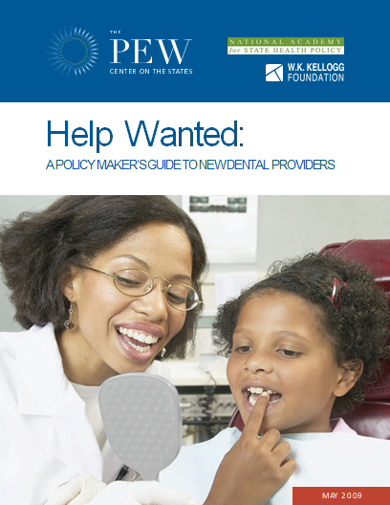
2009-10 The FIVE (9)-Year Battle in Kansas Kansas, New Mexico, Ohio, USA Wide, Vermont, Washington, Massachusetts

Slide 3


AAPD Responds
AAPD Responds to Kellogg Foundation Report on Dental Therapists
April 10, 2012 11:10 AM
CHICAGO – April 10th, 2012 — The American Academy of Pediatric Dentistry (AAPD)[i] commends the Kellogg Foundation for undertaking the monumental task of documenting dental therapists and their work in various countries by conducting an extensive review of the literature. The report, A Review of the Global Literature on Dental Therapists: In the Context of the Movement to Add Dental Therapists to the Oral Health Workforce in the United States, reviews the history and practice of dental therapists in 54 countries ranging from the United States to the United Kingdom to Malaysia, and makes broad-based conclusions regarding safety and effectiveness . However, the mid-level programs in these 54 countries differ so dramatically in scope of practice, populations served and degree of dentist supervision that it is difficult to make a genuine evaluation of the fit of dental therapy in the U.S. mainstream dental care system. Further, the AAPD is concerned that much of the literature cited is based on opinions rather than data, and further makes no conclusion as to the effect of these programs on the oral health of the targeted population.

Slide 4
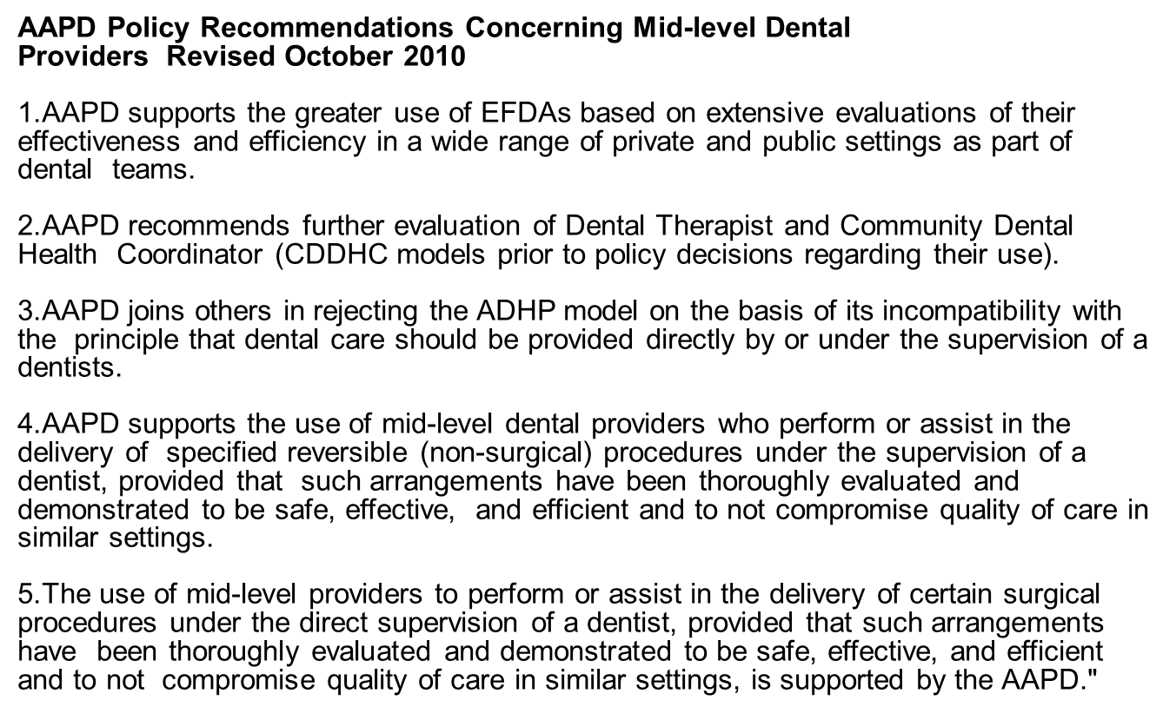
AAPD Recommends

Slide 5
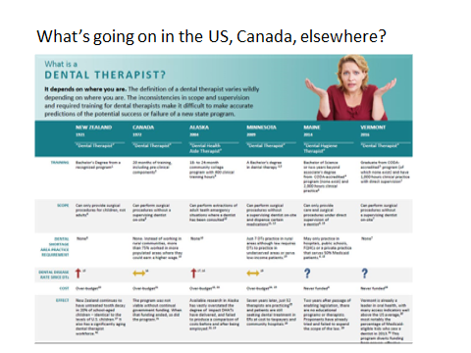
What is a Dental Therapist in Kansas?

Slide 6



Primary Drivers of DTs in Kansas

Slide 7

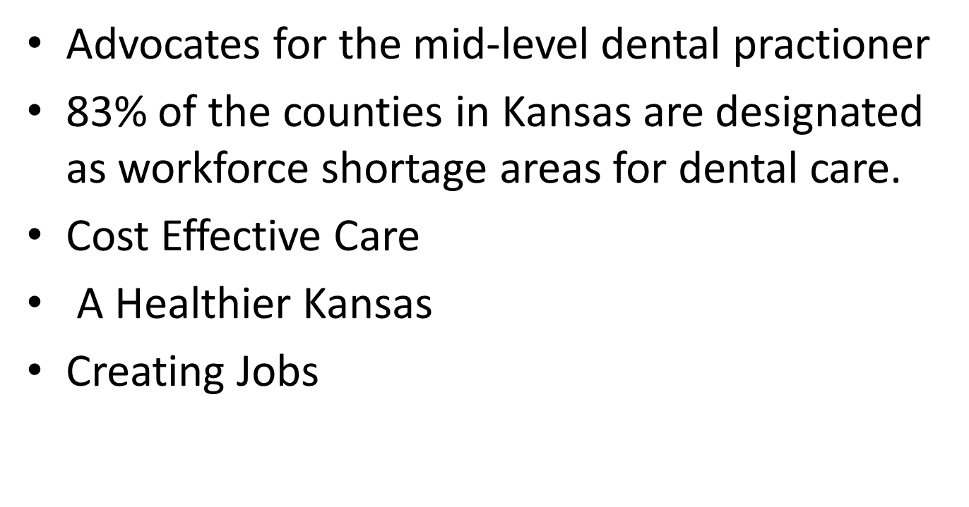

Slide 8
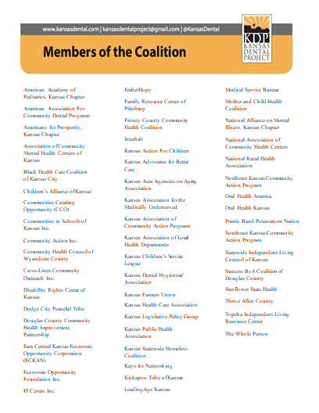

Slide 9
Dental Therapists, a free market solution?
Americans For Prosperity (AFP)- aligned with call to end occupational licensure
American Legislative Exchange Council (ALEC)

Slide 10
Drivers of Opposition in Kansas
Kansas Dental Association
Kansas Dental Board
Kansas Academy of General Dentistry
Kansas Academy of Pediatric Dentistry

Slide 11
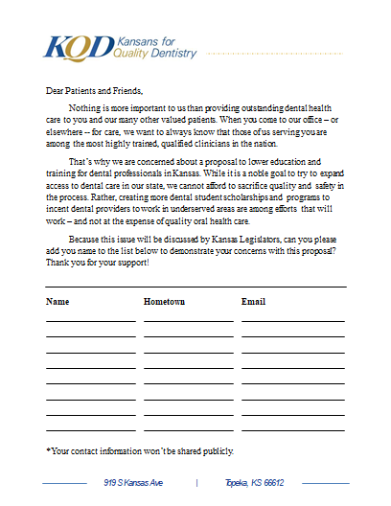

Slide 12
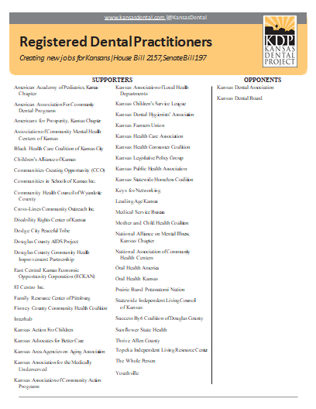

Slide 13
At What Point Should Compromise Be Considered?
Thoughts to be considered:

Slide 14
Dollars Spent
Since 2010, the KDA has spent about $1 million
Ask for voluntary contribution – 2010-2011
Institute a $125 assessment – 2012-present
Apply for SPA money from the ADA – 2011 ($27,000) – it increased to $60,000
Hire an additional lobby firm and a public relation firm

Slide 15
Legislative Costs
The issue has held us legislatively hostage for 8 years – insurance issues
We have used much political clout
We are seen as being uncompromising and protecting our own personal interests
Time out of practice to testify

Slide 16
Legislative Hearings
Full Committee Hearings 2011, 2015 and 2017
Round Tables in 2011, 2012 and 2013
Interim 2011
Brett Roufs, Cindi Sherwood, Mark Herzog, Nicole Rogers, Connie White, Lucynda Raben, Melodee Armfield, Jeff Stasch, Richard McFadden, John Fales, Nick Rogers, Glenn Hemberger (KDB) and possibly others

Slide 17
Attempts at Compromise 2010-2017
Several attempts with KAMU prior to 2014
KDA and KAC hired an arbitrator in 2013 to find compromise at the direction of Rep. Hawkins
All of the proponents invite three private dentists to meet - Excludes the KDA -11-16
KAMU and KAC meet with KDA – Kansas Dental Hygiene Association excluded 11-17
Senator Schmidt initiates a meeting with the KDA and KDHA 12-17

Slide 18
Compromise Considered 2018
The ADA is cutting its SPA money by 50%
The argument has become very difficult
The legislative body is growing weary of the issue – “corking” legislation
We have the support of the legislative leadership this year, but it may be lost – 2016 election
The legislative body may not support us – too close to predict
This may be our last chance to negotiate from a position of power

Slide 19
Sequence of Events Leading to Compromise
Senator Schmidt initiates a meeting with the KDA and KDHA - December 19, 2017
KDA – KDHA - January 2, 2018
January 5, Presented to KDA Exec. Committee – passed 5-0-1
January 19, 2018 Board of Delegate Meeting – passed 34-2
January 22, Senator Schmidt introduce SB 312
KDA Dental Day January 25, 2018

Slide 20
KDA Membership Notified
Initial email sent 1-24-2018
USPS packet with the same info was mailed to all members home addresses by the end of the week in a special envelope mark “Urgent Legislative Information”
Feb 7 – Single Topic Video Minute
Feb 26 – Update in Video Minute
March 5 – Open letter from all officers
March 30 – Update in Video Minute

Slide 21
Bullet Points for the Compromise
General/Direct supervision (depending on procedures) of a dentist therapist provided by a dentist employed by an indigent health clinic or Medicaid provider. (removes independent practice of DT)
KDHE/KDB study provided to legislature in 2030 to study the impact on access to care
KDHA/KDA agreement/letter work together on this version and not support versions of dental therapy legislation which may be offered by Kansas Dental Project or others. Also agree not to change substantively points of DT until 2030 unless mutual consent.

Slide 22
Bullet Points for the Compromise
CODA-Accredited DT course of study containing 500 hours of clinical training
Adding a dental therapist to the Kansas Dental Board is deleted
Some irreversible procedures are deleted and others allowed only under DIRECT supervision of a dentist
“Diagnosis” line is deleted
“Treatment plan” modified to “dental therapy care plan”
The number of dental therapists a dentist can supervise is limited to three

Slide 23
Historical Sequence of Events
February 1, 2018 - Senate Hearing, Public Health and Welfare Committee – passed
Senate - Passed 38-0 - February 15
Hearing in the House – March 14-no vote taken due to conflicts
Folded into telemedicine bill – HB 2674
Legislative session ends
Begin to Address Concerns from Membership at annual session

Slide 24
Next Year/Future
Dental Therapist Bill will resurface as another bill next year – KDP five year strategic plan
Potential loss of some SPA money
Another KDA Assessment
Damaged relationship with key members of legislature?
Committee Make-up of legislature and specifically, the committees
Unified KDA voice?

Slide 25
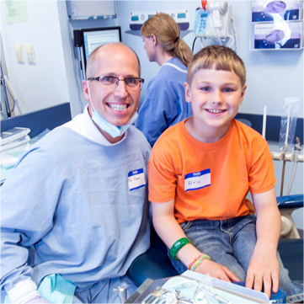

Slide 26
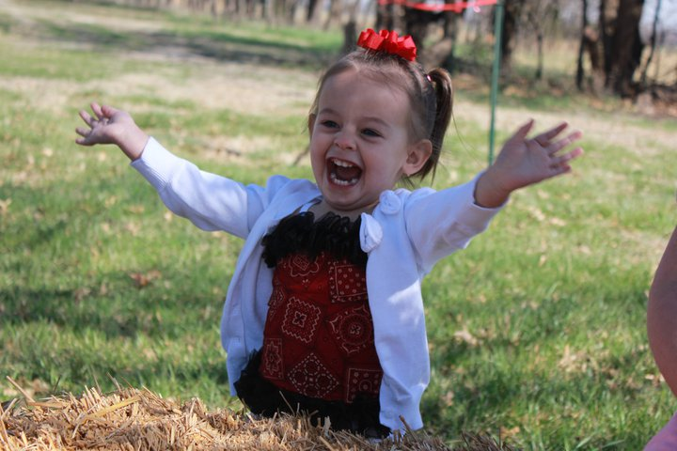
THANK YOU!

