Slide 1
American Academy of
Pediatric Dentistry
Biennial Chapter Leadership Summit
September 28-29, 2018
Chicago, Illinois
John S. Rutkauskas, DDS, MBA, CAE
Chief Executive Officer
Paul Amundsen, MNA, CFRE
Vice President for Development and Charitable Programs
Healthy Smiles, Healthy Children: The Foundation of
the American Academy of Pediatric Dentistry

Slide 2
AAPD Vision
Optimal oral health for all children

Slide 3
AAPD Mission
To advance optimal oral health for all children by delivering outstanding service that meets and exceeds the needs and expectations of our members, partners, and stakeholders.

Slide 4
AAPD Culture
Our members put children first in everything they do, and at the highest standards of ethics and patient safety. As such, the American Academy of Pediatric Dentistry is THE leading national advocate dedicated exclusively to children’s oral health. We are the embodiment of our members’ expertise as the big authorities on little teeth.

Slide 5
AAPD Strategic Objectives
Clinical Expertise
  We equip our members and all other providers with data, knowledge, competencies and skills to provide safe, high-quality, evidence-based patient care in the context of a Dental Home.

Slide 6
AAPD Strategic Objectives
Patient Care and Access
  We help members address barriers to care, such as parent oral health literacy and affordability; reduce administrative burdens for payment/reimbursement; and invest in community-based initiatives providing care to underserved children.

Slide 7
AAPD Strategic Objectives
Workforce and Practice Transformation
  We support the pediatric dental workforce, expanding its reach and to better address children’s oral health needs. We develop practical tools and resources to help all members in any practice setting build and sustain high-functioning dental care practices to the benefit of their patients and their communities.

Slide 8
AAPD Strategic Objectives
Advocacy
  We take a solutions-based approach to educating the broader dental profession, local, state and national policy makers, and consumers/parents about critical issues affecting child oral health in the United States.

Slide 9
AAPD Strategic Objectives
Operations
  We maintain organizational effectiveness by meeting and exceeding accepted professional association management standards.

Slide 10
We are not a member-driven organization…
We are not a staff-driven organization…
We are a Vision- and Mission-driven organization!!

Slide 11
AAPD Organizational Chart
Source: 2018 Membership Directory

Slide 12
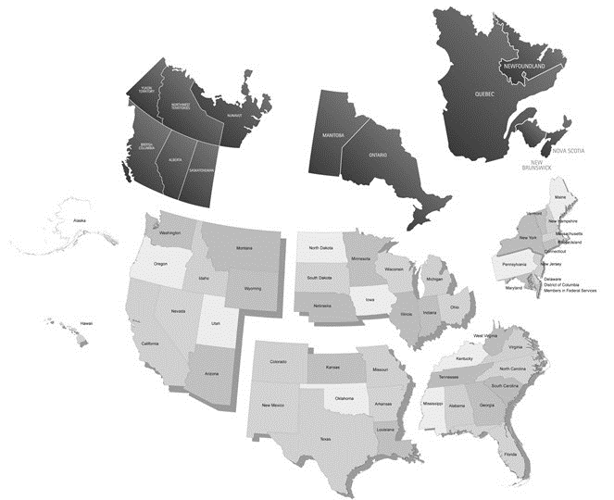
AAPD District Organizations

Slide 13
AAPD District Organizations
Northeastern District
  Connecticut, Delaware, District of Columbia, Maine, Maryland, Massachusetts, New Hampshire, New Jersey, New York, Pennsylvania, Rhode Island, Vermont, and the Canadian provinces of Newfoundland, Nova Scotia, Prince Edward Island, New Brunswick, and Quebec
Southeastern District
  Alabama, Florida, Georgia, Kentucky, Mississippi, North Carolina, South Carolina, Tennessee, Virginia, West Virginia, and the Commonwealth of Puerto Rico
NorthCentral District
  Illinois, Indiana, Iowa, Ohio, Michigan, Minnesota, Nebraska, North Dakota, South Dakota, Wisconsin, and the Canadian provinces of Ontario and Manitoba
Southwestern District
  Arkansas, Colorado, Kansas, Louisiana, Missouri, New Mexico, Oklahoma, and Texas
Western District
  Alaska, Arizona, California, Hawaii, Idaho, Montana, Nevada, Oregon, Utah, Washington, Wyoming, and the Canadian provinces of Saskatchewan, Alberta, British Columbia, Northwest Territories, Nunavut, and Yukon Territory

Slide 14
Organizational Governance
Legislative Body
Voting Membership (General Assembly)
Elects Officers:
  President
  President-Elect
  Vice President
  Secretary-Treasurer
Administrative Body
Board of Trustees
Appoints Officers:
  Parliamentarian
  Congressional Liaison
  Editor-in-Chief
  Chief Executive Officer

Slide 15
Elected Officers
Nominated positions:
  Secretary-Treasurer
  At-Large Trustee
  American Board of Pediatric Dentistry Director
  Affiliate Trustee
Nominations must be Active or Life Members (except for Affiliate Trustee)
Nominations are evaluated by the Nominations Committee for each elective office to be filled
Elections held at the General Assembly at the Annual Session
Notes:
Only Active and Life members have voting privileges in the General Assembly, so (with the exception of the Affiliate Trustee), only they can be officers.

Slide 16
Board of Trustees
18 Members:
  Executive Committee: President, President-Elect, Vice President, Secretary-Treasurer, Immediate Past President, Parliamentarian
  One District Trustee elected from each of the five districts
  Three trustees elected as Trustee At-Large
    One of these at-large positions is designated for and filled by a full time academician
  One Affiliate Member Trustee
  One Editor-in-Chief
  One Congressional Liaison
  One Chief Executive Officer

Slide 17
Elected Officers, 2018-2019
President
Joseph Castellano
President-Elect
Kevin J. Donly
Vice President
Jessica Y. Lee
Secretary-Treasurer
K. Jean (Jeannie) Beauchamp
Immediate Past President
James D. Nickman

Slide 18
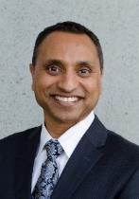
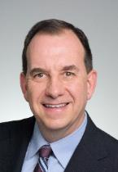
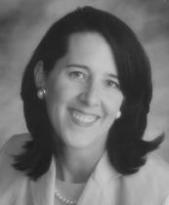
2018-2019 Board of Trustees
Northeastern Trustee (Term ends 2019)
Deven V. Shroff, D.M.D.
Ellicott City, Md.
Southeastern Trustee (Term ends 2020)
J. C. Shirley, D.M.D., M.S.
Atlanta, Ga.
NorthCentral Trustee (Term ends 2019)
Jessica A. Meeske, D.D.S., M.S.
Hastings, Neb.

Slide 19
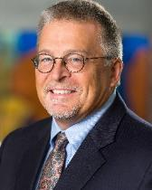
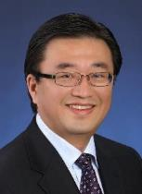
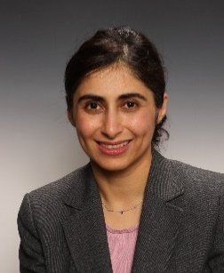
2018-2019 Board of Trustees
Southwestern Trustee (Term ends 2021)
John T. Fales, Jr., D.D.S.
Olathe, KS
Western Trustee (Term ends 2021)
Jacob K. Lee, D.D.S.
San Clemente, Calif.
Academic At-Large Trustee (Term ends 2021)
Homa Amini, D.D.S., M.S., M.P.H.
Columbus, Ohio

Slide 20
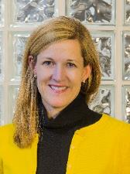
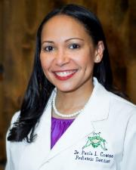

2018-2019 Board of Trustees
At-Large Trustee (Term ends 2019)
Tegwyn H. Brickhouse, D.D.S., Ph.D.
Richmond, Va.
At-Large Trustee (Term ends 2019)
Paula L. Coates, D.D.S., M.S.
South Riding, Va.
Affiliate Trustee (Term open)
Kerry Maguire, D.D.S., M.S.P.H.
Belmont, Mass.

Slide 21
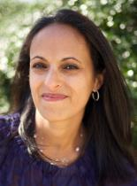

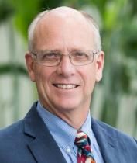

2018-2019 Board of Trustees
Parliamentarian
Anupama Rao Tate, D.M.D., M.P.H.
Washington, D.C.
Congressional Liaison
Heber Simmons, Jr., D.D.S.
Jackson, Miss.
Editor-in-Chief
Noel Childers, D.D.S., M.S., Ph.D.
Birmingham, Ala.
Chief Executive Officer
John S. Rutkauskas, D.D.S., M.B.A., CAE
Chicago, Ill.

Slide 22
Appointments to Councils and Committees
All members nominated by the President-Elect.
Become effective when President-Elect becomes President.
President-Elect receives help for nominations from:
  Board of Trustees
  District Organizations
  Current Councils and Committees.
Individuals may also volunteer

Slide 23
AAPD Councils
Council on Annual Session
Council on Continuing Education
Council on Government Affairs
Council on Membership and Membership Services
Council on Clinical Affairs
Council on Pre-Doctoral Education
Council on Post-Doctoral Education
Council on Scientific Affairs

Slide 29
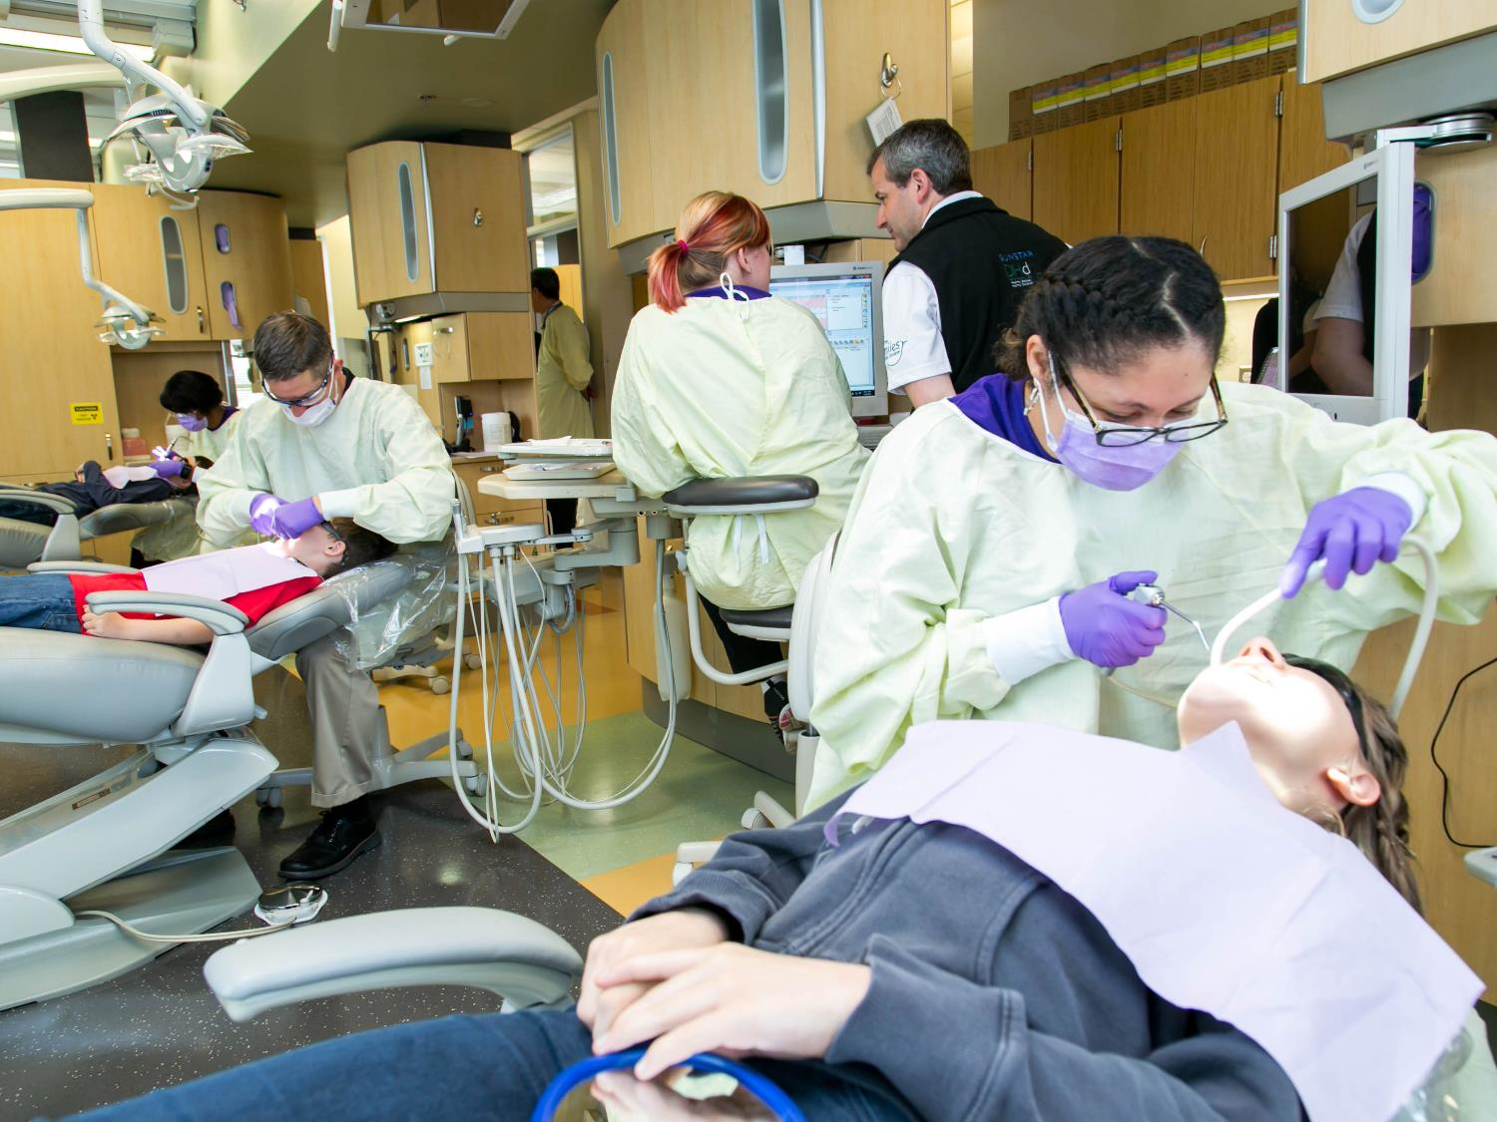
Healthy smiles, healthy children:
The Foundation of the AAPD

Slide 30
Healthy smiles, healthy children:
The Foundation of the AAPD
We’re the $18 million* charitable arm of the AAPD

Slide 31
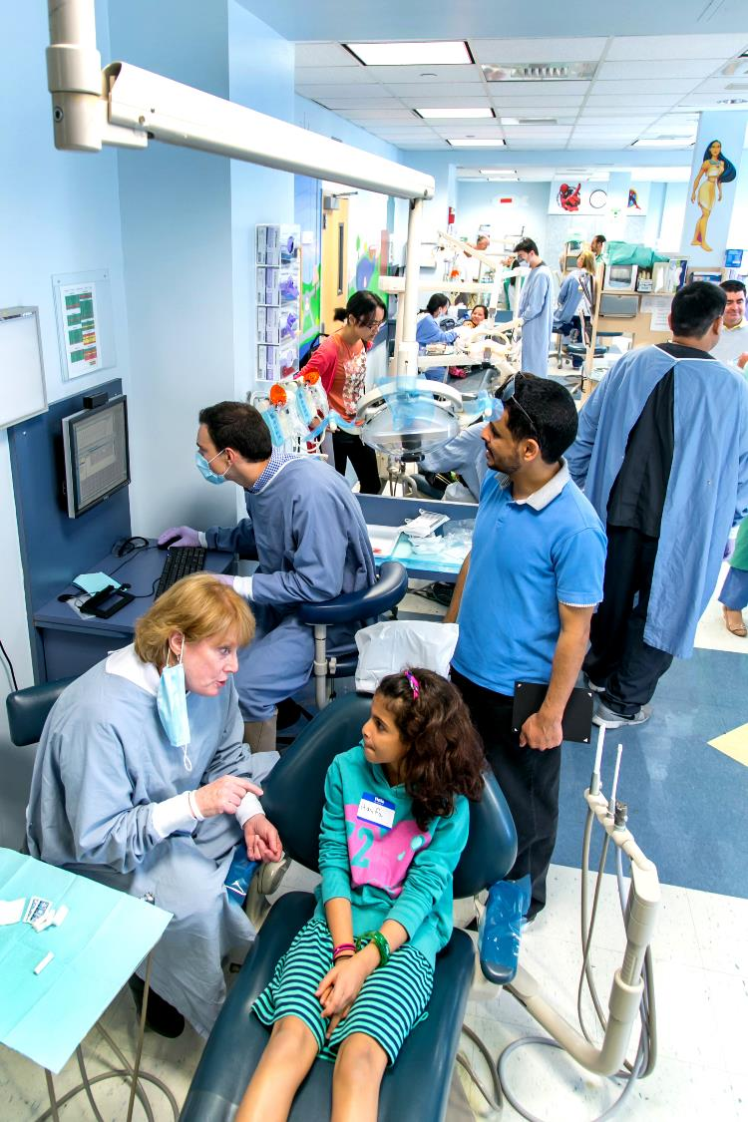
HSHC supports community-based initiatives providing dental homes for children from families that cannot afford dental care.
What we do

Slide 32
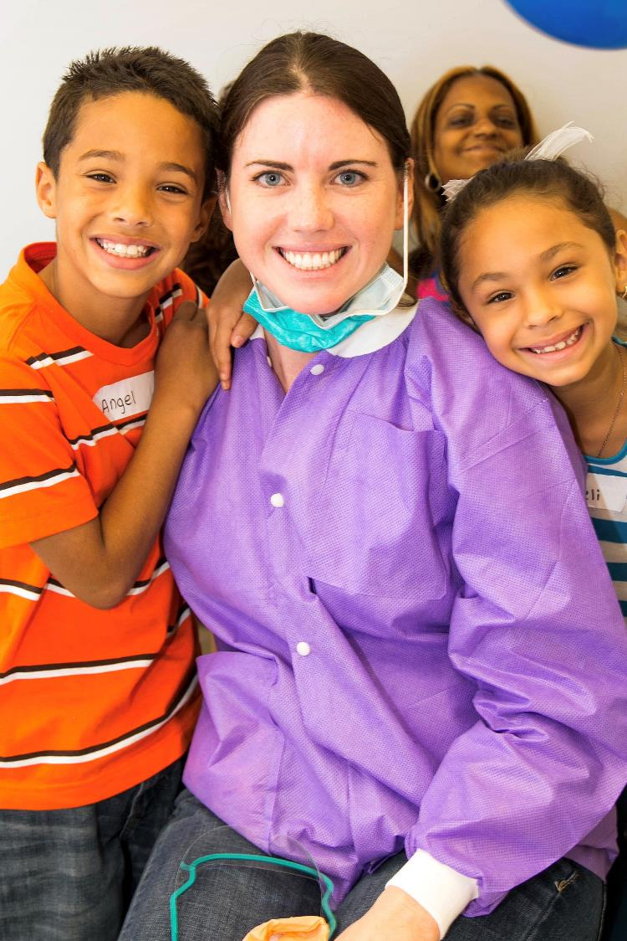
we raise money and give grants to agencies and clinics nationwide that provide dental care to underserved children.
Put another way

Slide 33
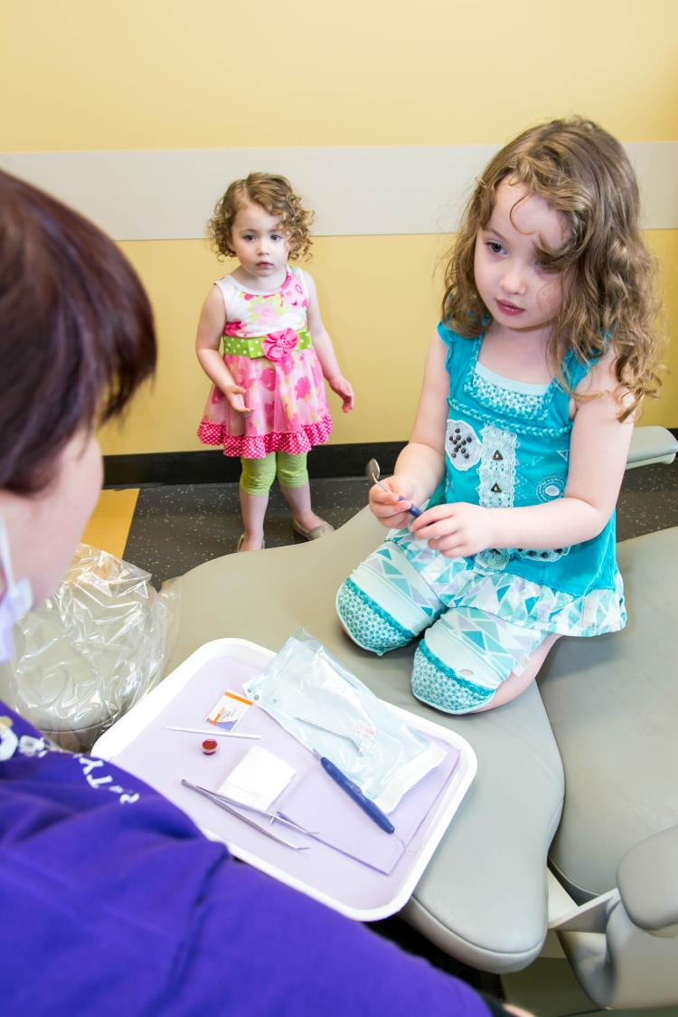
We help kids
Access to Care Grants (1 year, $20,000)
Multi-Year Access to Care Grants (3- and 5-year, $75,000 per year)
Dental Home Day (at Annual Session)
Pilot replication grants (up to $125,000)*

Slide 34
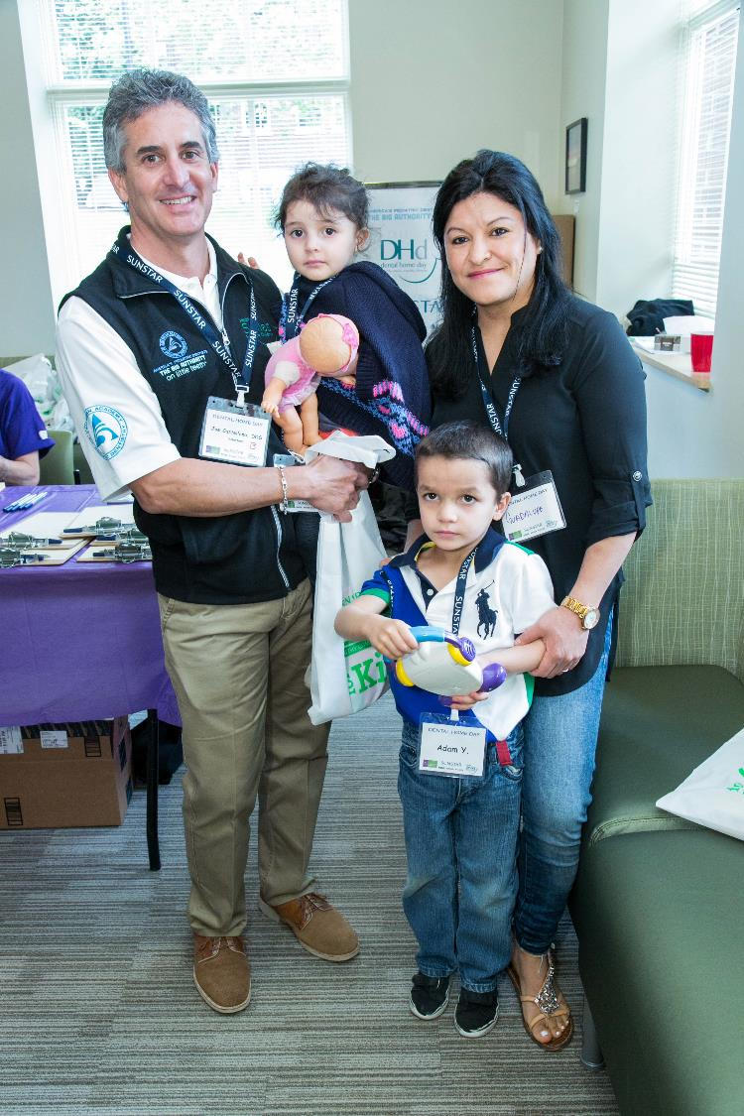
HSHC has issued grants in every aapd district since 2010 TOTALING nearly $5 million
We’re In your backyard

Slide 35
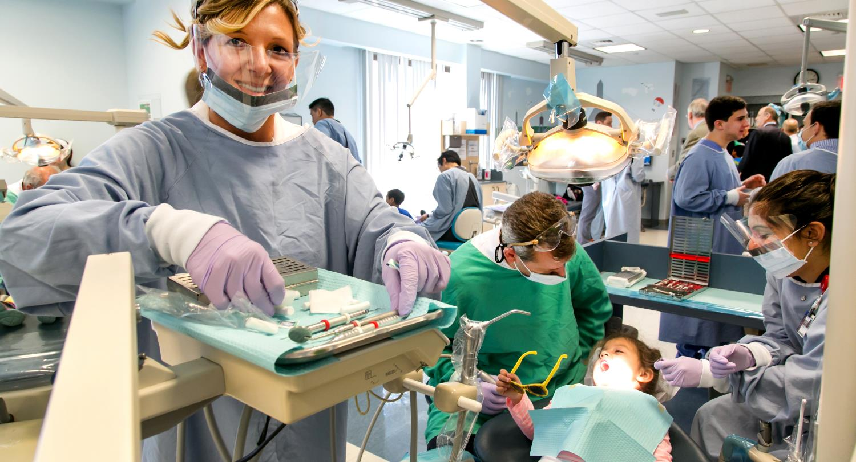
to more than 350,000 Children
since 2010, HSHC grantees have provided dental homes

Slide 36
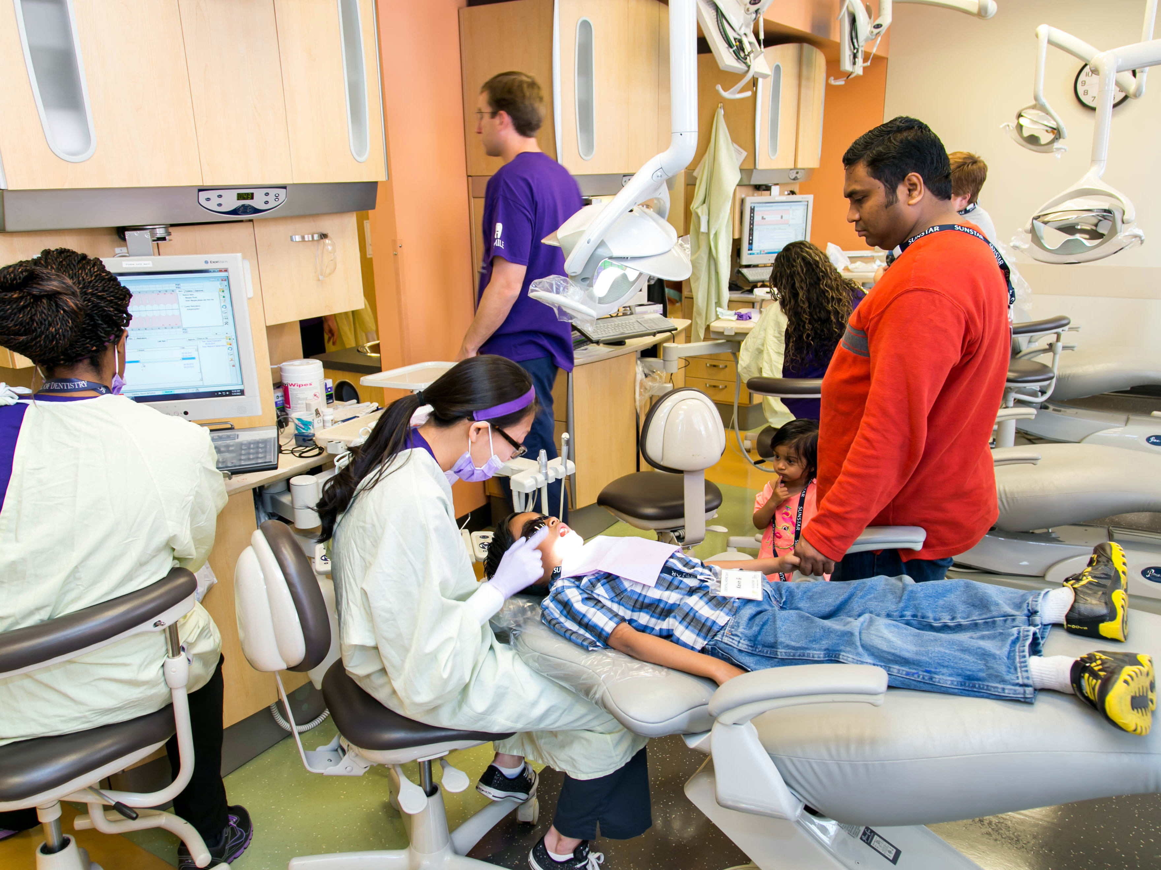
HSHC IS the #1 national, dentist-led charity PROMOTING child oral health
By any measure HSHC…

Slide 37
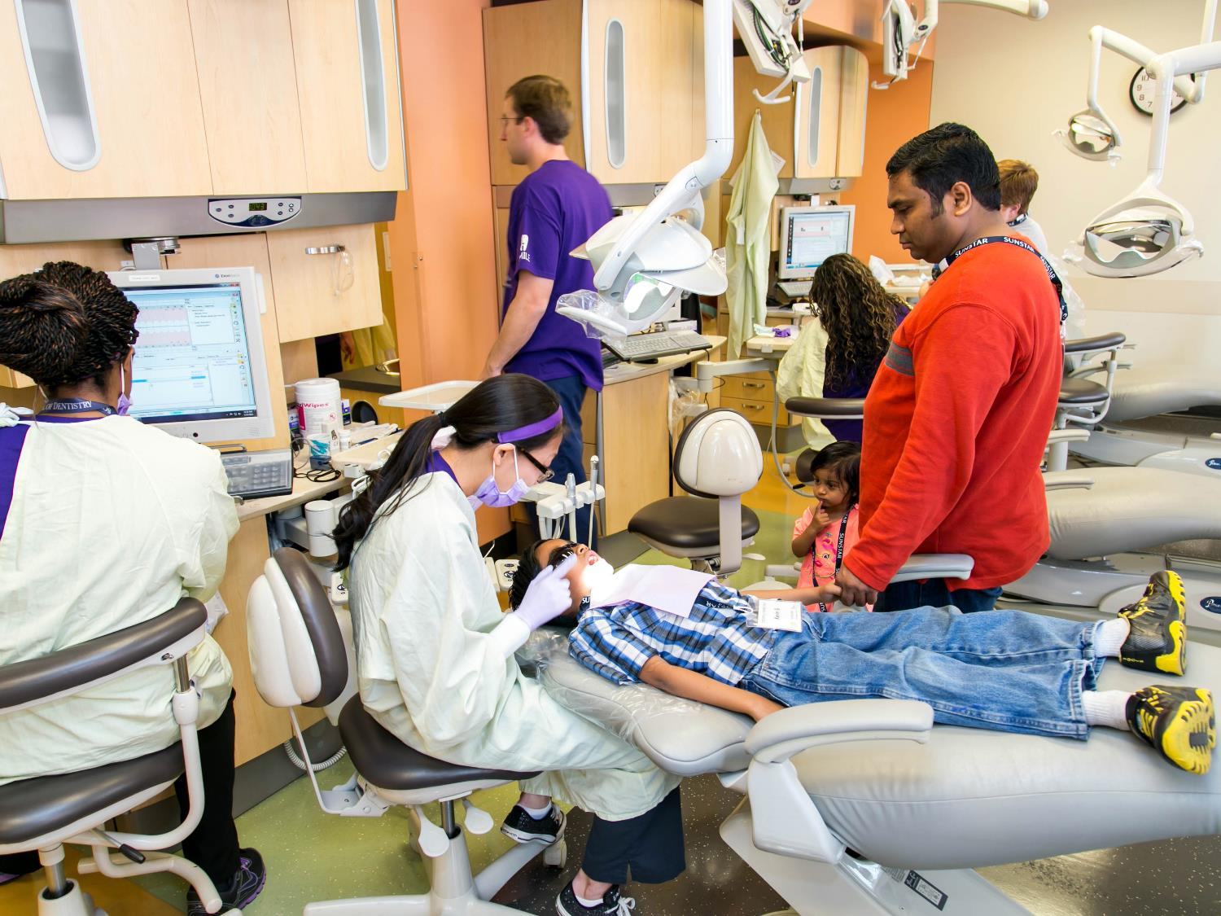
HSHC IS the #1 national, dentist-led charity PROMOTING child oral health
By any measure HSHC…
… and we’re just getting warmed up!

Slide 38
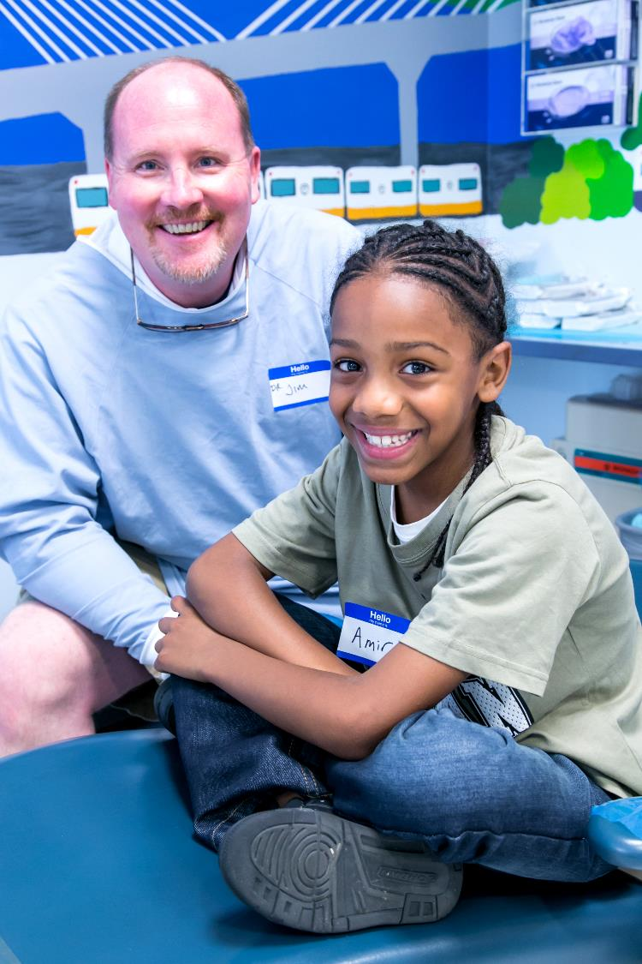
HOW HSHC HELPS you
Providing grants in your states, Districts
Connecting with volunteers
Offering technical assistance

Slide 39
Why it matters

Slide 40
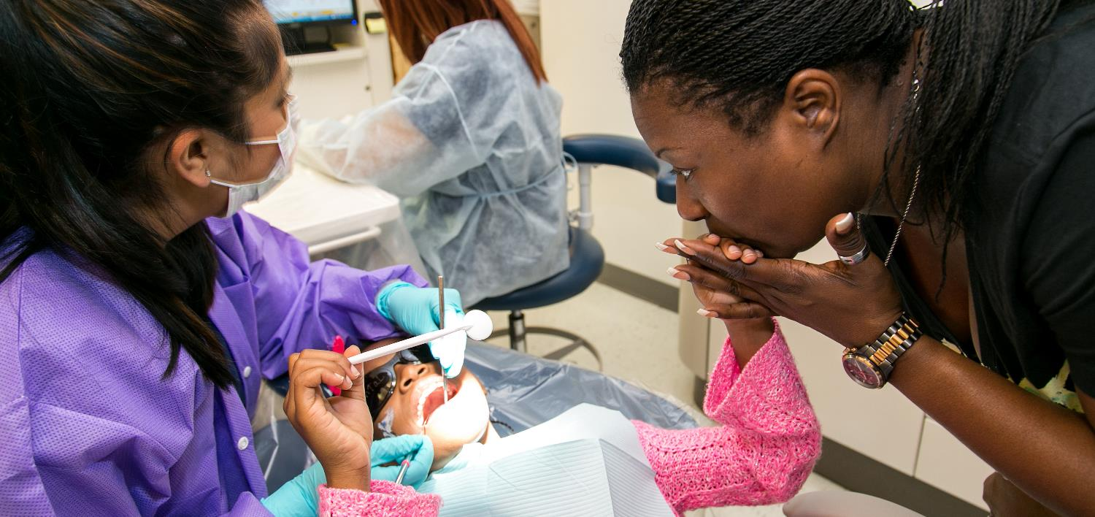
“I can’t explain how appreciative I am of having the opportunity to take my kids to a great group of dentists. I know my kids are in the best hands.”
–mom of hSHC grantee patient

Slide 41
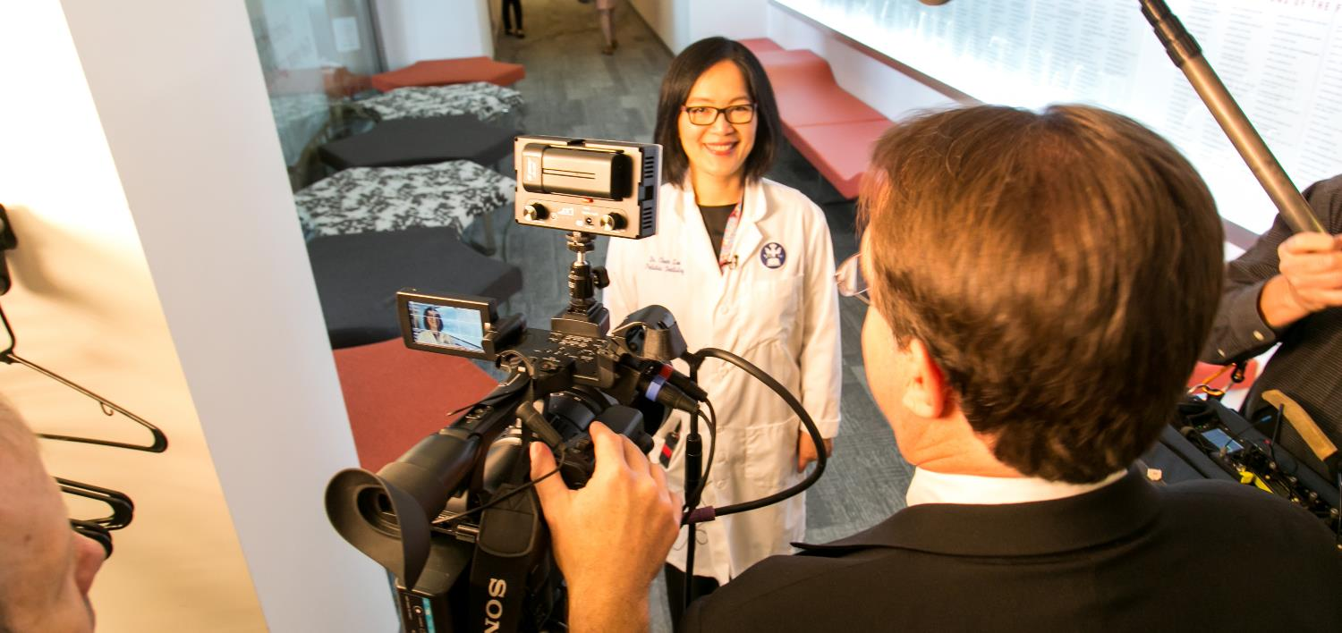
“Funding from HSHC is like receiving the golden seal of approval and validation for your program — confirming you’re doing something right in improving the lives of children.”
- HSHC grantee dentist

Slide 42
