Slide 1
State/District Chapter Dues Collection

Slide 2
AAPD Collects
36 States 4 Districts

Slide 3
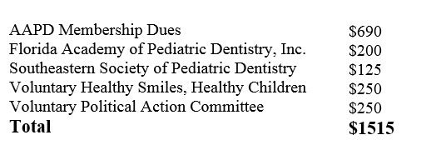
Dues Collection
Started collecting dues for states in 2010
Make as turnkey as possible
Listed on the AAPD Dues statement

Slide 4
Renewal Cycle
Must be on AAPD’s renewal cycle July 1 – June 30.
Non renewals
Moving in or out of state
Members paying the state directly and not through AAPD

Slide 5
Outliers
People who do not live in your state but want to belong
Membership Categories that do not mirror AAPD

Slide 6
Remittance Checks
Remittance checks
1st July/August mailed September
2nd September/October mailed November
3rd November/December/January mailed February
4th February – May mailed in June

Slide 7
Dues Reports
Paid
Total paid membership
Remittance
Members who paid during that period
Unpaid
Paid AAPD but not Chapter

Slide 8
Changes
Changes in membership dues must be to AAPD in writing by March 31.
New Chapters coming on to dues collection need to have paper work in by March 31.
Please keep us up to date on any changes in address you would like the checks to go and officer rotations.

Slide 9
Chapter Relations

Slide 10
New Position
Chapter Relations and Database Coordinator
Discovery Phase -- How to best serve AAPD State and District Chapters
Look at other associations and their component relation efforts
Learn your “pain point” and offer suggestion
Ultimately, we want to HEAR from YOU, The AAPD Chapters

Slide 11


New Position
SPY? Or Liaison?
Liaison of course!

Slide 12
State and District Relations
Handle Remittance and Chapter requests (rosters, reports)
Attend State and District meetings when invited
Increase volunteers on the state and district level
PDT Chapter Columns – highlight state chapters activities or best practices

Slide 13
Connecting predoctoral chapters to State Chapters
PREDOCTORAL CHAPTERS
Increase Branding/Marketing with AAPD
Help Predoctoral Chapters gain more awareness of AAPD
Increase ties between Predoctoral Chapters and State Chapters – Mentor/Mentee : States/Predoctoral Members

Slide 14
Future of Chapter relations
Chapter Resources on new Website
YES – New MEMBER HOME too!
Survey and Analyze current status / Recommendations for the future
Future possibilities include
Run reports online any time
Provide training sessions and other resources
Governance, program development, community outreach, membership, marketing…

Slide 15
Questions?
Suzanne Wester, Membership and Marketing Director swester@aapd.org
David Hydorn, Chapter Relations and Database Coordinator dhydorn@aapd.org

