Slide 1
PPA outreach to key players and organizations in the community
Patrice B. Wunsch, DDS MD
PPA Virginia Society of Pediatric Dentistry

Slide 2
Outreach
State Level
Virginia Dental Association
Virginia Society of Pediatric Dentistry
Virginia Oral Health Coalition
Virginia Department of Health
American Academy of Pediatrics, Virginia Chapter
Board of Directors includes Dr. Bruce Rubin, Chair Department of Pediatrics, VCU
National Level
American Academy of Pediatric Dentistry
Council on Government Affairs
Public Policy Advocates
American Academy of Pediatrics

Slide 3
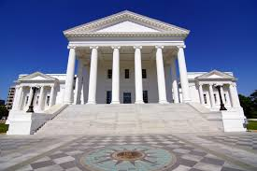
Virginia State Capital
Virginia Dental Association
Lobby for what is in the best interest of the dentist/patient/public
Passed the Medicaid Deferred Compensation Bill that enables dentists to defer a certain portion of their reimbursement from Medicaid into a tax free retirement account
Virginia Oral Health Coalition
Lobby for what is in the best interest of the patient/public
Attempt to have legislations passed to expand Medicaid for adult patients

Slide 4
Issues Affecting Pediatric Dentists in Virginia
Moderate Sedation Permit Inspections
Virginia Board of Dentistry
Fluoridation in Spotsylvania
Anti-fluoridation group
Specialty Advertising
Fast-track motion blocked by more than 10 specialists present at BOD meeting
Open for public comment
Nearly 300 dental specialists in Virginia posted comments in opposition
VSPD and AAPD posted a joint letter in opposition

Slide 5
Moderate Sedation Permit Inspections
Issue
Virginia Board of Dentistry announced that any dentist that holds an Enteral Conscious/Moderate Sedation permit was subject to unannounced inspections by Professional Inspectors state employees
VSPD Annual Meeting Speakers (March 6, 2015)
Faculty member
Sedation update by Dr. Malinda Husson (pediatric dentist/dental anesthesiologist)
Board representatives
Explained the inspection process
Practicing pediatric dentist
Describe his experience after his office received an announced inspection

Slide 6
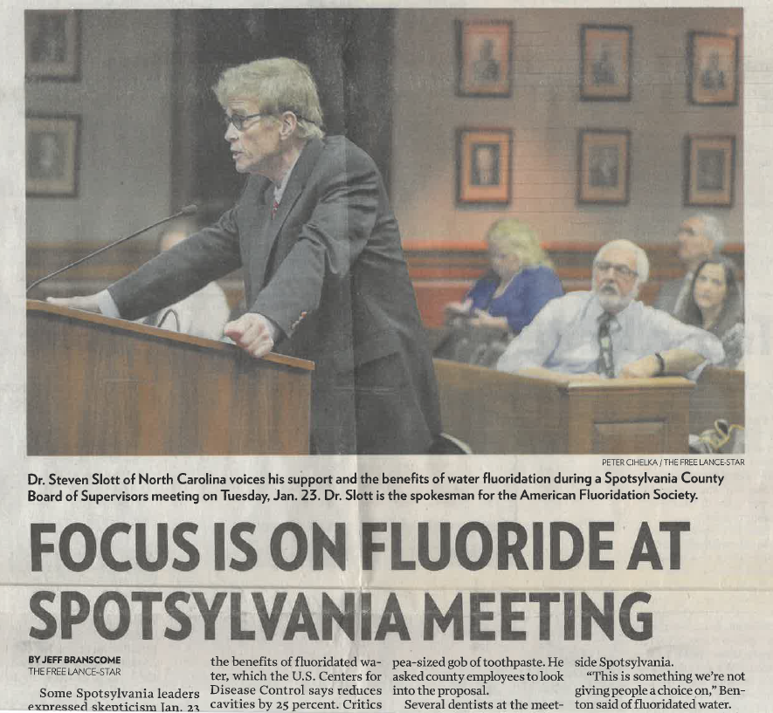
Fluoridation in Spotsylvania, VA
Meeting January 2018, vote to keep water fluoridation
Spotsylvania adds 0.7 mg of fluoride per liter to municipal water
Those in opposition:
“ complained that their water bill does not include warnings about added fluoride, people should have a choice”
“Fluoride is linked to Alzheimer's disease, cancer, diabetes heart disease, infertility and may other adverse health outcomes”
“should list fluoride levels of county water on water bills”
Notes:
Jan. 23, 2018
Dr. Steven Slott of North Carolina and Dr. Johnny Johnson from the American Fluoridation Society are present as well as members of the VaOHC and the VSPD President and VCU Pediatric Dentistry Resident
Johnny Johnson, Jr., DMD, MS
Pediatric Dentist
Diplomate American Board of Pediatric Dentistry
​Life Fellow, American Academy of Pediatric Dentistry
President, American Fluoridation Society
www.AmericanFluoridationSociety.org
@AFS_Fluoride
Steven D. Slott, DDS
Burlington, NC. 27216

Slide 7
AAP Campaign for Dental Health
Building Effective Statewide Teams for Fluoridation
Invite to attend conference on fluoridation (March 20-21, 2018)
VA representatives (VSPD PPA, VDH and VaOHC)
Contributors:
Kansas Dental Champions & Statewide Water Action Teams
The Midwest Collaborative Initiative
Presentations:
Fluoridation, where it started
How it works
Identifying Community Champions
Know your Resources

Slide 8
Virginia’s Fluoridation Regulations
July 2018
The Office of Drinking Water (ODW) within the Virginia Department of Health (VDH) is in the process of reviewing and updating the Waterworks Regulations on Community Water Fluoridation (CWF)
Waterworks owners need to provide written notice to the Health Commissioner at least 90 days before intending to start or stop CWF
Waterworks owners need to provide written notice to their consumers at least 90 days before intending to start or stop CWF
The Board of Health recommends all community waterworks provide the optimal level of fluoride, as determined by the U.S. Department of Health and Human Services
Notes:
July 31, 2018
Waterworks owners need to provide written notice to the Health Commissioner at least 90 days before intending to start or stop CWF. If a waterworks owner decides to stop CWF, or has been instructed to stop CWF by the local governing body, the owner must provide notice to the Commissioner and wait at least 90 days before stopping CWF. This delay will provide VDH time to ensure the local healthcare community is aware of the intent or actual decision.
Waterworks owners need to provide written notice to their consumers at least 90 days before intending to start or stop CWF. Owners must make a reasonable effort to notify all of the people that consume water from the waterworks. The proposed amendments specify the methods owners must use for notification: mail; publication in a local newspaper or newsletter; delivery of multiple copies for distribution by apartment building owners, large private employers, or community centers; etc. Notice to the consumers about fluoridation changes may be included in the annual Consumer Confidence Report, but that alone is not sufficient. More comprehensive distribution requirements are required.
The Board of Health recommends all community waterworks provide the optimal level of fluoride, as determined by the U.S. Department of Health and Human Services. "Community waterworks" serve at least 15 service connections used by year-round residents, or at least 25 year-round residents. The Regulations (12VAC5-590-930) currently state that the Board of Health may require CWF "[w]here practicable and feasible[.]" The Board has never exercised this authority and the word “require” has left localities somewhat confused as to VDH’s stance on CWF.

Slide 9
Specialty Advertising
History
State boards in FL, TX, CA sued by practitioners challenging specialty status due to the existence of the American Board of Dental Specialties (ABDS) and won
These results conclude that the ADA is no longer the authority on specialty recognition
Situation in VA
Practitioner petitioned the board requesting they amend the restriction on advertising dental specialties
Board voted to move forward with a fast-track regulation to appease the petitioner
March 2018
September 2018
Hurricane Florence
Notes:
March 2018
several specialists voice opposition to fast-track action (greater than 10)
VDA is involved and has taken action to inform it’s members
Board decided to withdraw Fast-track action and that a Notice of Intended Regulatory Action (NOIRA) was submitted to start the regulatory process
September 2018
Board welcomes comments before Regulatory Action is Taken
VSPD/AAPD compose joint letter in opposition to the proposed regulatory action
VSPD post letter and send email blast to membership concerning the issue
Nearly 300 comments are posted (mostly in opposition to making changes to the current restriction on specialty advertising by Orthod, Perio, Pedo, OMFS and Prosth)
Hurricane Florence
- Board meeting scheduled on September 14th to decide on regulatory action is cancelled due to Florence and rescheduled for October 19th

Slide 10
Virginia Dental Association
Council on Government Affairs
Legislation on tax exempt retirement account for treating patients on Medicaid
Moderate sedation
Opiate Crisis (Prescription Monitoring)
Support Mission of Mercy projects
Influenza vaccination on hold, exploring the need to promote HPV vaccination
Specialty Advertising
VDA Legislative Day on the Hill
3rd Friday in January with Council Meetings the next day
Attendees

Slide 11
Virginia Oral Health Coalition
Efforts to promote access to care and improve the oral health of Virginians across the state
Virginia Oral Health Summit 2018 Agenda
The State of Health in Virginia
Keynote: Race and Health in America, The Gardener's Tale
Motivational Interviewing
Medicaid Expansion in Virginia
Building a System that Cares for Vulnerable Populations
Promoting Fluoridated Water

Slide 12

Virginia Society of Pediatric Dentistry
Past Issues:
Small membership, difficult to reach all members since VA is a large state
Difficulty in collecting dues
Leadership
Solutions:
Tripartite membership with the AAPD collecting the dues
Public Policy Advocate
Networks with PPAs from other states
Able to call on them for help
Create district trustees who can represent various parts of the state

Slide 13
Summary
Advocacy
Patient centered
Practitioner centered
Pediatric Dentistry at the State Level
Ways to become involved
Attend meetings
Networking
Take on leadership roles
Volunteer

